Slide 1
Pointers
Chapter 8 of C++ How to Program, 10/e

Slide 2
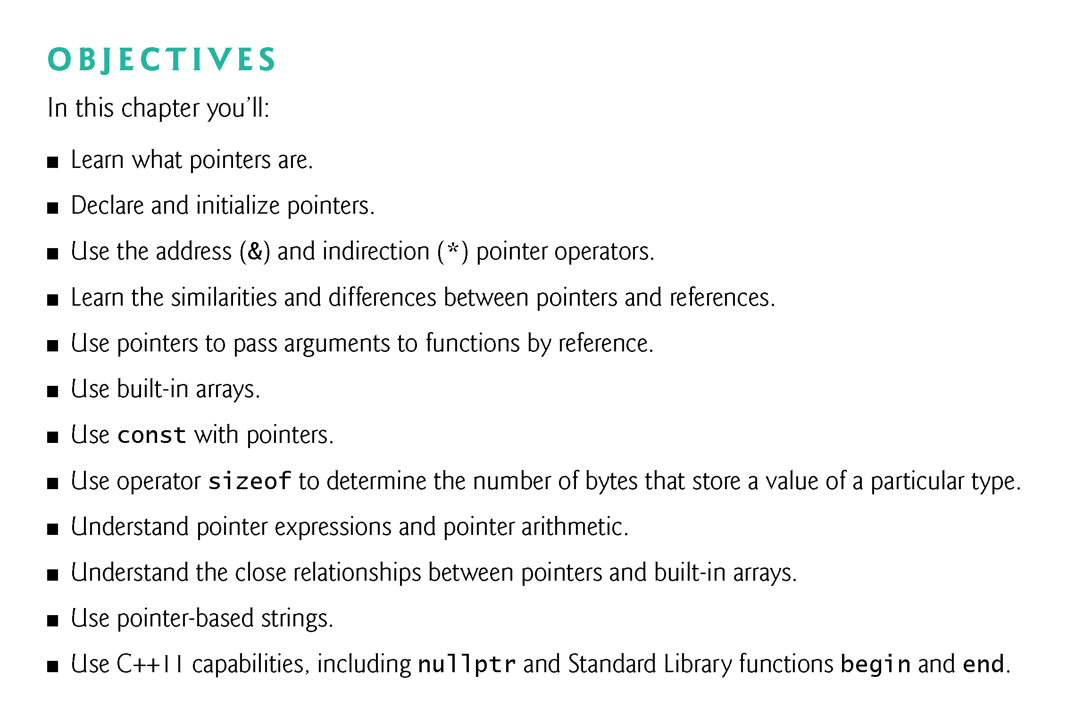

Slide 3
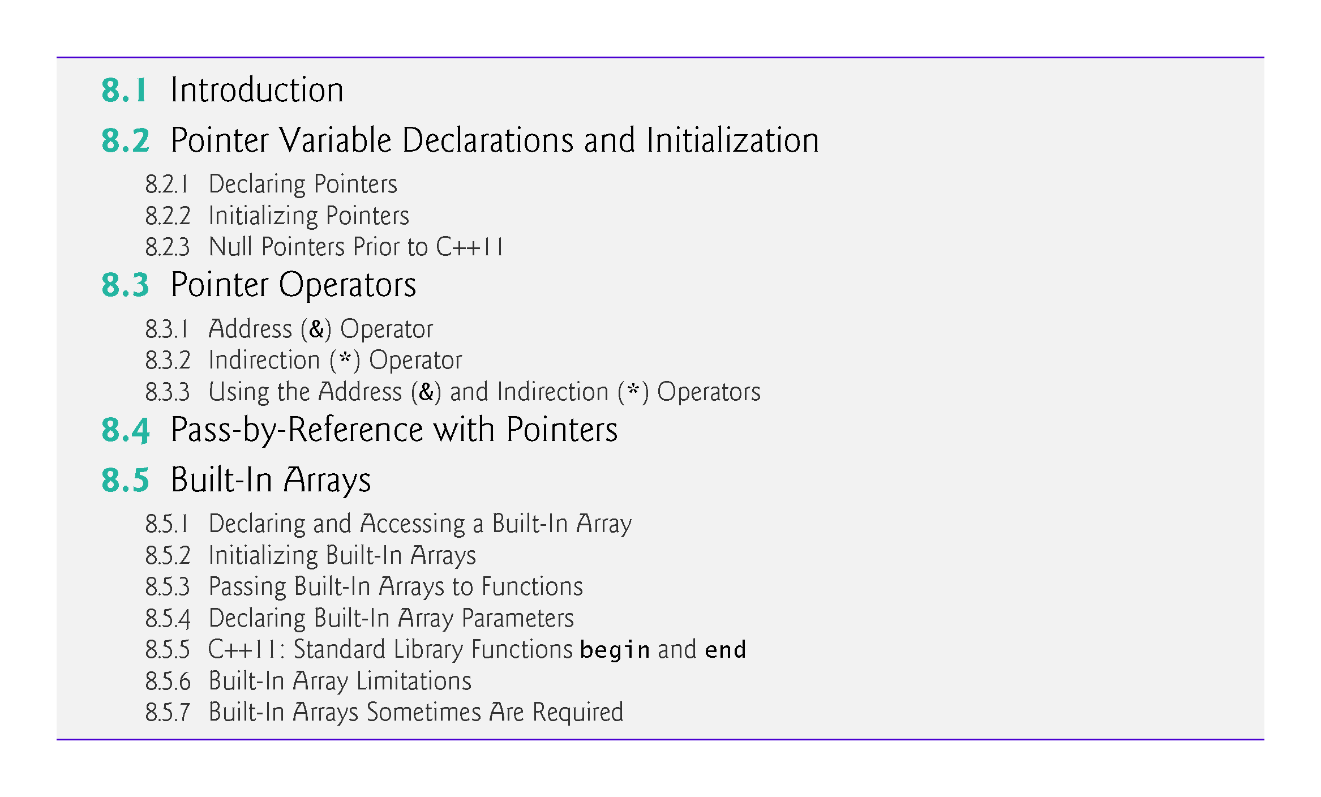

Slide 4
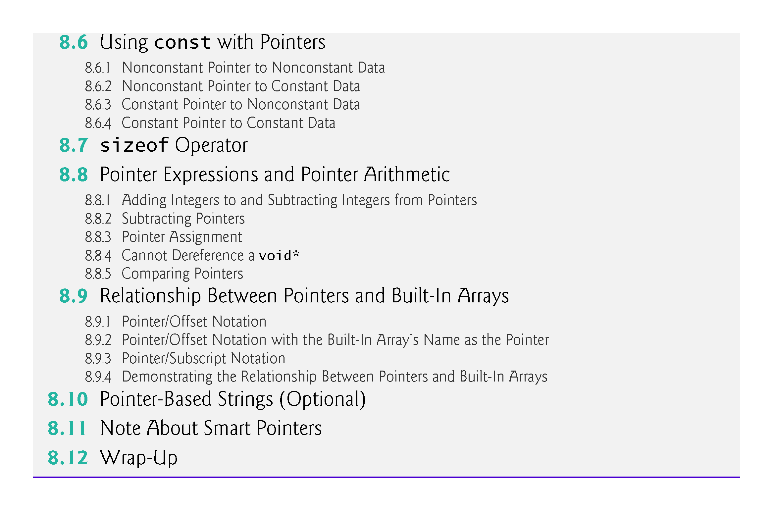

Slide 5
8.1 Introduction
Pointers are one of the most powerful, yet challenging to use, C++ capabilities.
We’ll discuss when it’s appropriate to use pointers, and show how to use them correctly and responsibly.
Pointers also enable pass-by-reference and can be used to create and manipulate pointer-based dynamic data structures.
We also show the intimate relationship among built-in arrays and pointers.
In new software development projects, you should favor array and vector objects to built-in arrays.

Slide 6
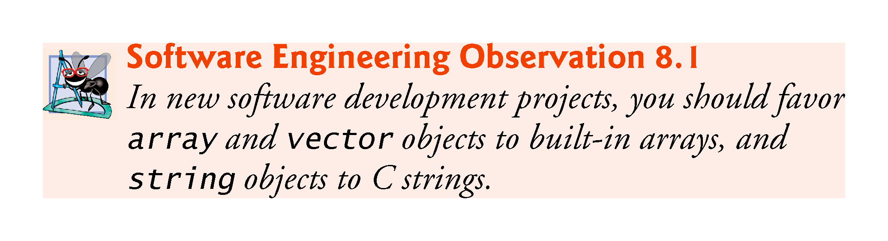

Slide 7
8.2 Pointer Variable Declarations and Initialization
A pointer contains the memory address of a variable that, in turn, contains a specific value.
In this sense, a variable name directly references a value, and a pointer indirectly references a value.
Referencing a value through a pointer is called indirection.
Diagrams typically represent a pointer as an arrow from the variable that contains an address to the variable located at that address in memory.

Slide 8
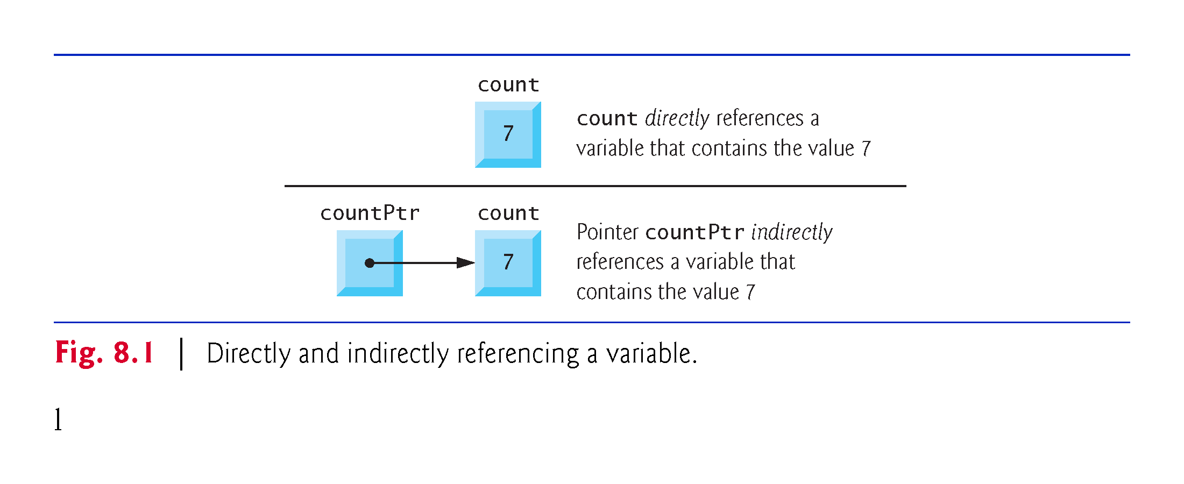

Slide 9
8.2.1 Delcaring Pointers
The declaration
int* countPtr, count;
declares the variable countPtr to be of type int* (i.e., a pointer to an int value) and is read (right to left), “countPtr is a pointer to int.”
Variable count in the preceding declaration is declared to be an int, not a pointer to an int.
The * in the declaration applies only to countPtr.
Each variable being declared as a pointer must be preceded by an asterisk (*).
When * appears in a declaration, it is not an operator—it indicates that the variable being declared is a pointer.
Pointers can be declared to point to objects of any type.

Slide 10
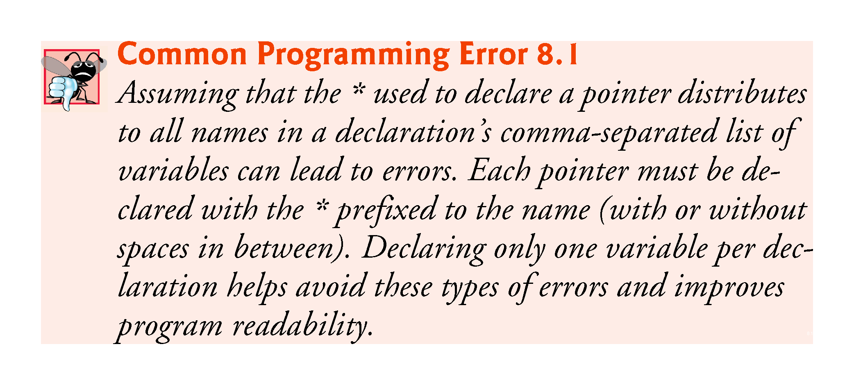

Slide 11
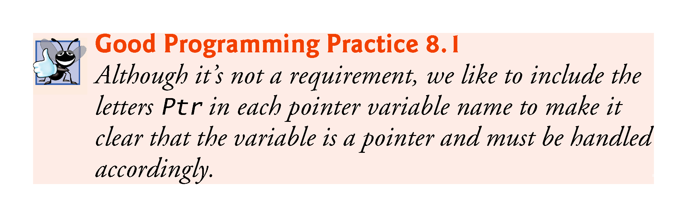

Slide 12
8.2.2 Initializing Pointers
Pointers should be initialized to nullptr (new in C++11) or to a memory either when they’re declared or in an assignment.
A pointer with the value nullptr “points to nothing” and is known as a null pointer.
From this point forward, when we refer to a “null pointer” we mean a pointer with the value nullptr.

Slide 13
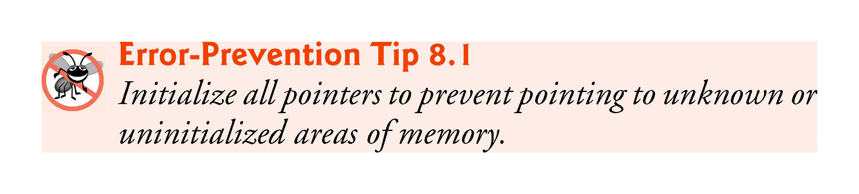

Slide 14
8.2.3 Null Pointers Prior to C++11
In earlier versions of C++, the value specified for a null pointer was 0 or NULL.
NULL is defined in several standard library headers to represent the value 0.
Initializing a pointer to NULL is equivalent to initializing a pointer to 0, but prior to C++11, 0 was used by convention.
The value 0 is the only integer value that can be assigned directly to a pointer variable without first casting the integer to a pointer type.

Slide 15
8.3 Pointer Operators
The unary operators & and * are used to create pointer values and “dereference” pointers, respectively.

Slide 16
8.3.1 Address (&) Operator
The address operator (&) is a unary operator that obtains the memory address of its operand.
Assuming the declarations
int y{5}; // declare variable y int* yPtr{nullptr}; // declare pointer variable yPtr
the statement
yPtr = &y; // assign address of y to yPtr
assigns the address of the variable y to pointer variable yPtr.
Figure 8.2 shows a representation of memory after the preceding assignment.

Slide 17
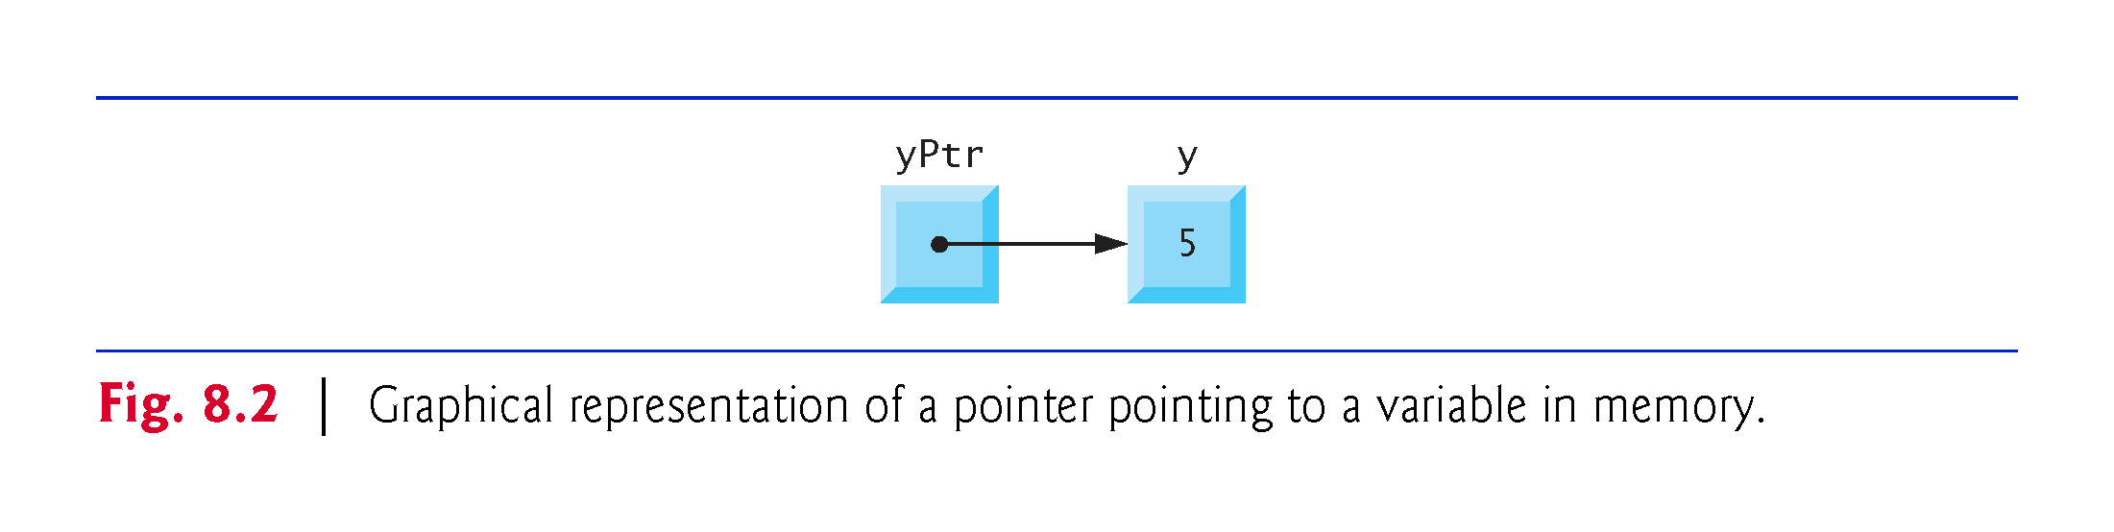

Slide 18
8.3.1 Address (&) Operator
Figure 8.3 shows another pointer representation in memory with integer variable y stored at memory location 600000 and pointer variable yPtr stored at location 500000.
The operand of the address operator must be an lvalue—the address operator cannot be applied to constants or to expressions that result in temporary values (like the results of calculations).

Slide 19
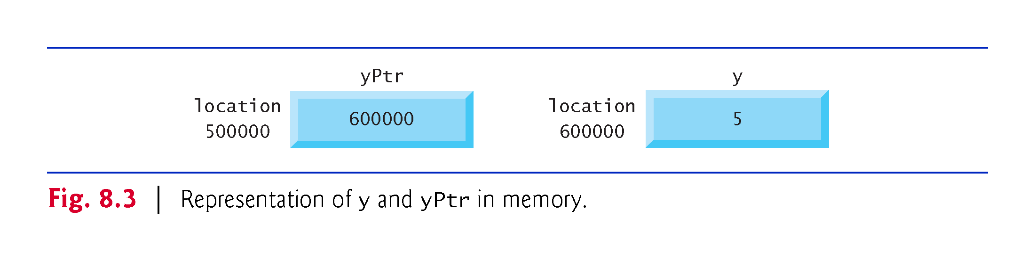

Slide 20
8.3.2 Indirection (*) Operator
The unary * operator—commonly referred to as the indirection operator or dereferencing operator—returns an lvalue representing the object to which its pointer operand points.
Called dereferencing a pointer
A dereferenced pointer may also be used as an lvalue on the left side of an assignment.

Slide 21
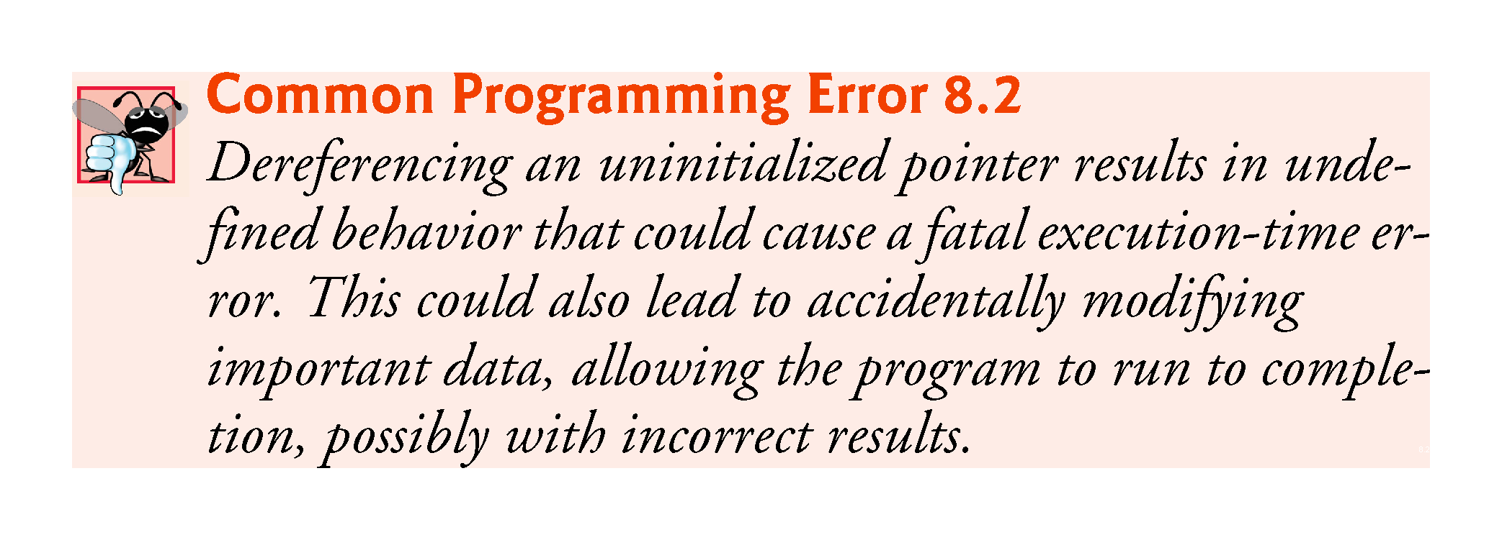

Slide 22
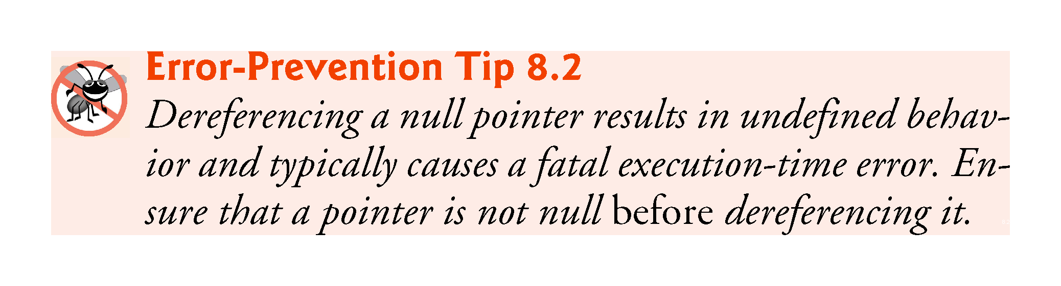

Slide 23
8.3.3 Using the Address (&) and Indirection (*) Operators
The program in Fig. 8.4 demonstrates the & and * pointer operators.

Slide 24
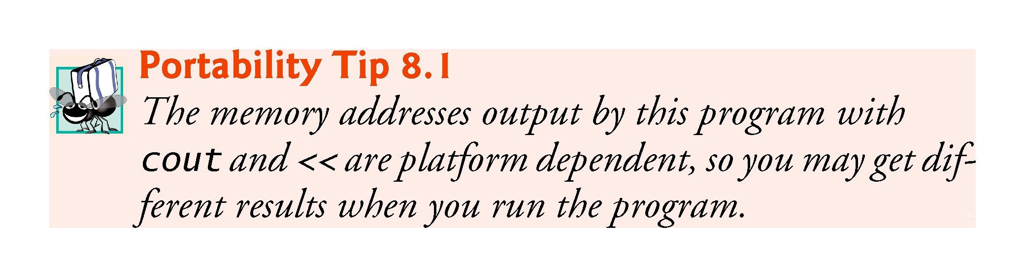

Slide 25
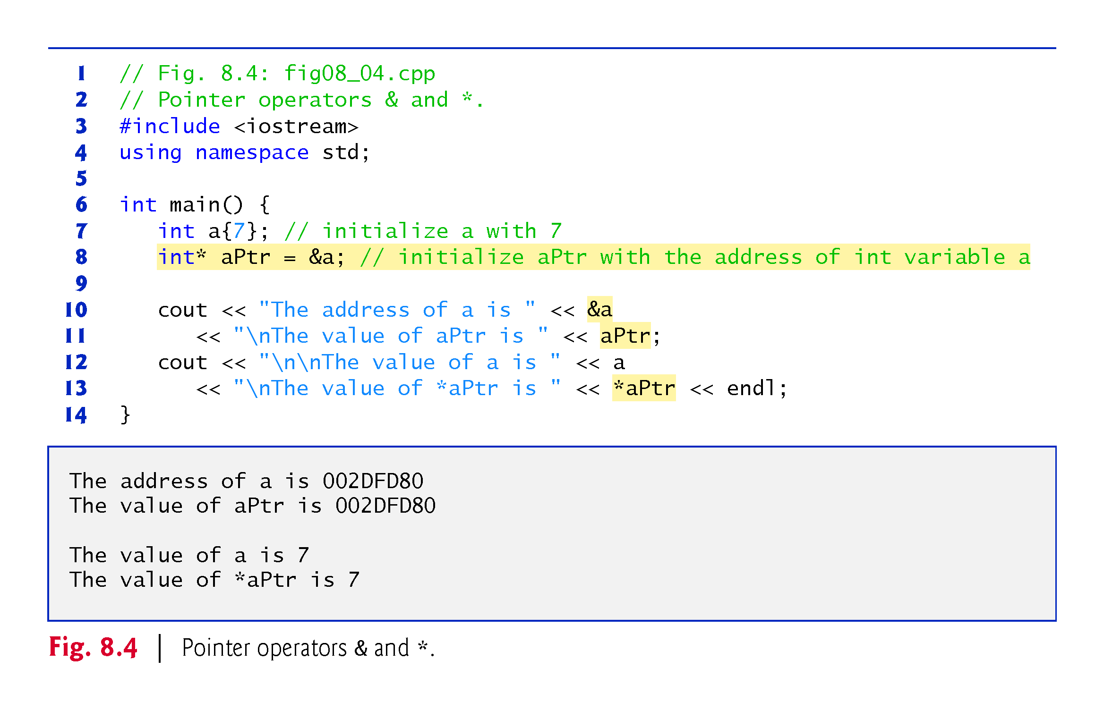

Slide 26
8.3.3 Using the Address (&) and Indirection (*) Operators
Precedence and Associativity of the Operators Discussed So Far
Figure 8.5 lists the precedence and associativity of the operators introduced to this point.
The address (&) and dereferencing operator (*) are unary operators on the fourth level.

Slide 27
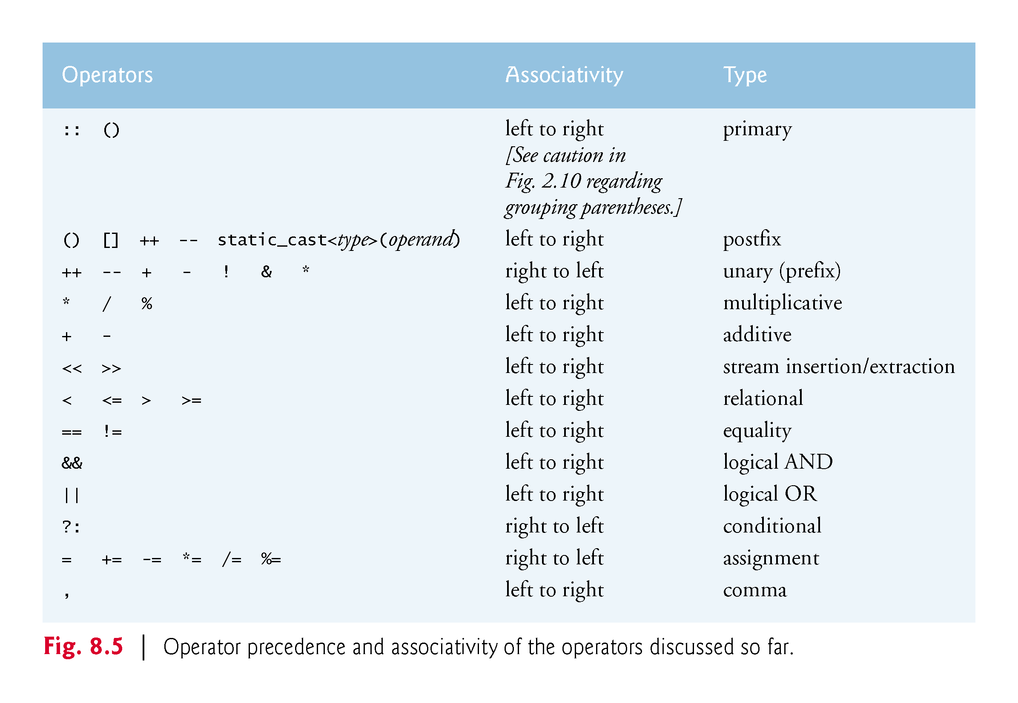

Slide 28
8.4 Pass-by-Reference with Pointers
There are three ways in C++ to pass arguments to a function
pass-by-value
pass-by-reference with reference arguments
pass-by-reference with pointer arguments.
Here, we explain pass-by-reference with pointer arguments.

Slide 29
8.4 Pass-by-Reference with Pointers
Pointers can be used to modify one or more variables in the caller or to pass pointers to large data objects to avoid the overhead of copying the objects.
You can use pointers and the indirection operator (*) to accomplish pass-by-reference.
When calling a function with an argument that should be modified, the address of the argument is passed.

Slide 30
8.4 Pass-by-Reference with Pointers (cont.)
An Example of Pass-By-Value
Figure 8.6 passes variable number by value to function cubeByValue, which cubes its argument and passes the new value result back to main using a return statement.
The calling function has the opportunity to examine the function call’s result before modifying any variable’s values.

Slide 31
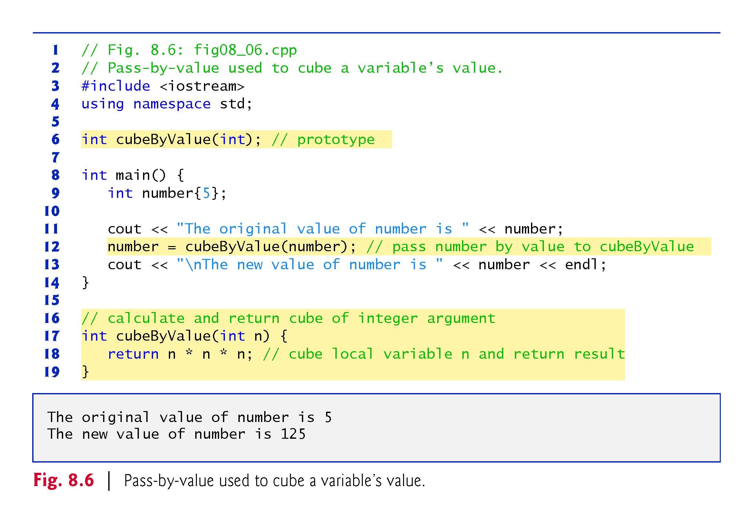

Slide 32
8.4 Pass-by-Reference with Pointers (cont.)
An Example of Pass-By-Reference with Pointers
Figure 8.7 passes the variable number to function cubeByReference using pass-by-reference with a pointer argument—the address of number is passed to the function.
The function uses the dereferenced pointer to cube the value to which nPtr points.
This directly changes the value of number in main.

Slide 33
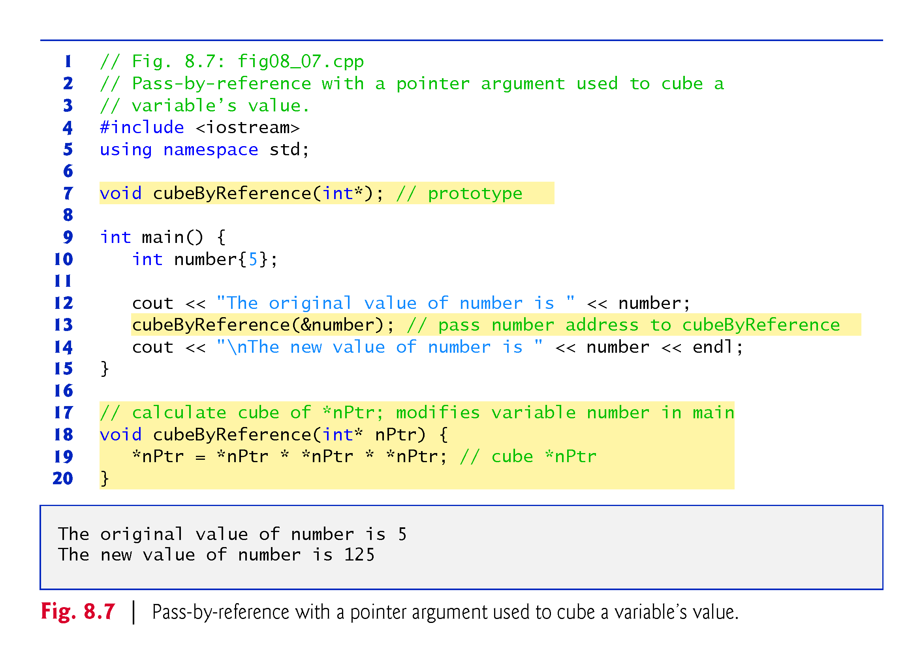

Slide 34
8.4 Pass-by-Reference with Pointers (cont.)
Insight: All Arguments Are Passed By Value
Passing a variable by reference with a pointer does not actually pass anything by reference—a pointer to that variable is passed by value and is copied into the function’s corresponding pointer parameter.
The called function can then access that variable in the caller simply by dereferencing the pointer, thus accomplishing pass-by-reference.

Slide 35
8.4 Pass-by-Reference with Pointers (cont.)
Graphical Analysis of Pass-By-Value and Pass-By-Reference
Figures 8.8–8.9 analyze graphically the execution of the programs in Fig. 8.6 and Fig. 8.7, respectively.
In the diagrams, the values in blue rectangles above a given expression or variable represent the value of that expression or variable.
Each diagram’s right column shows functions cubeByValue (Fig. 8.6) and cubeByReference (Fig. 8.7) only when they’re executing.

Slide 36
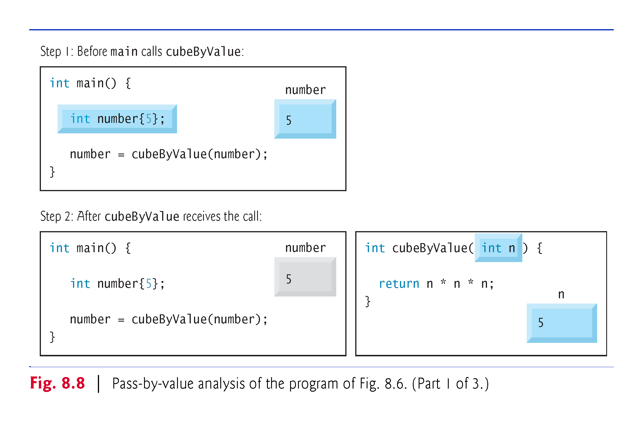

Slide 37
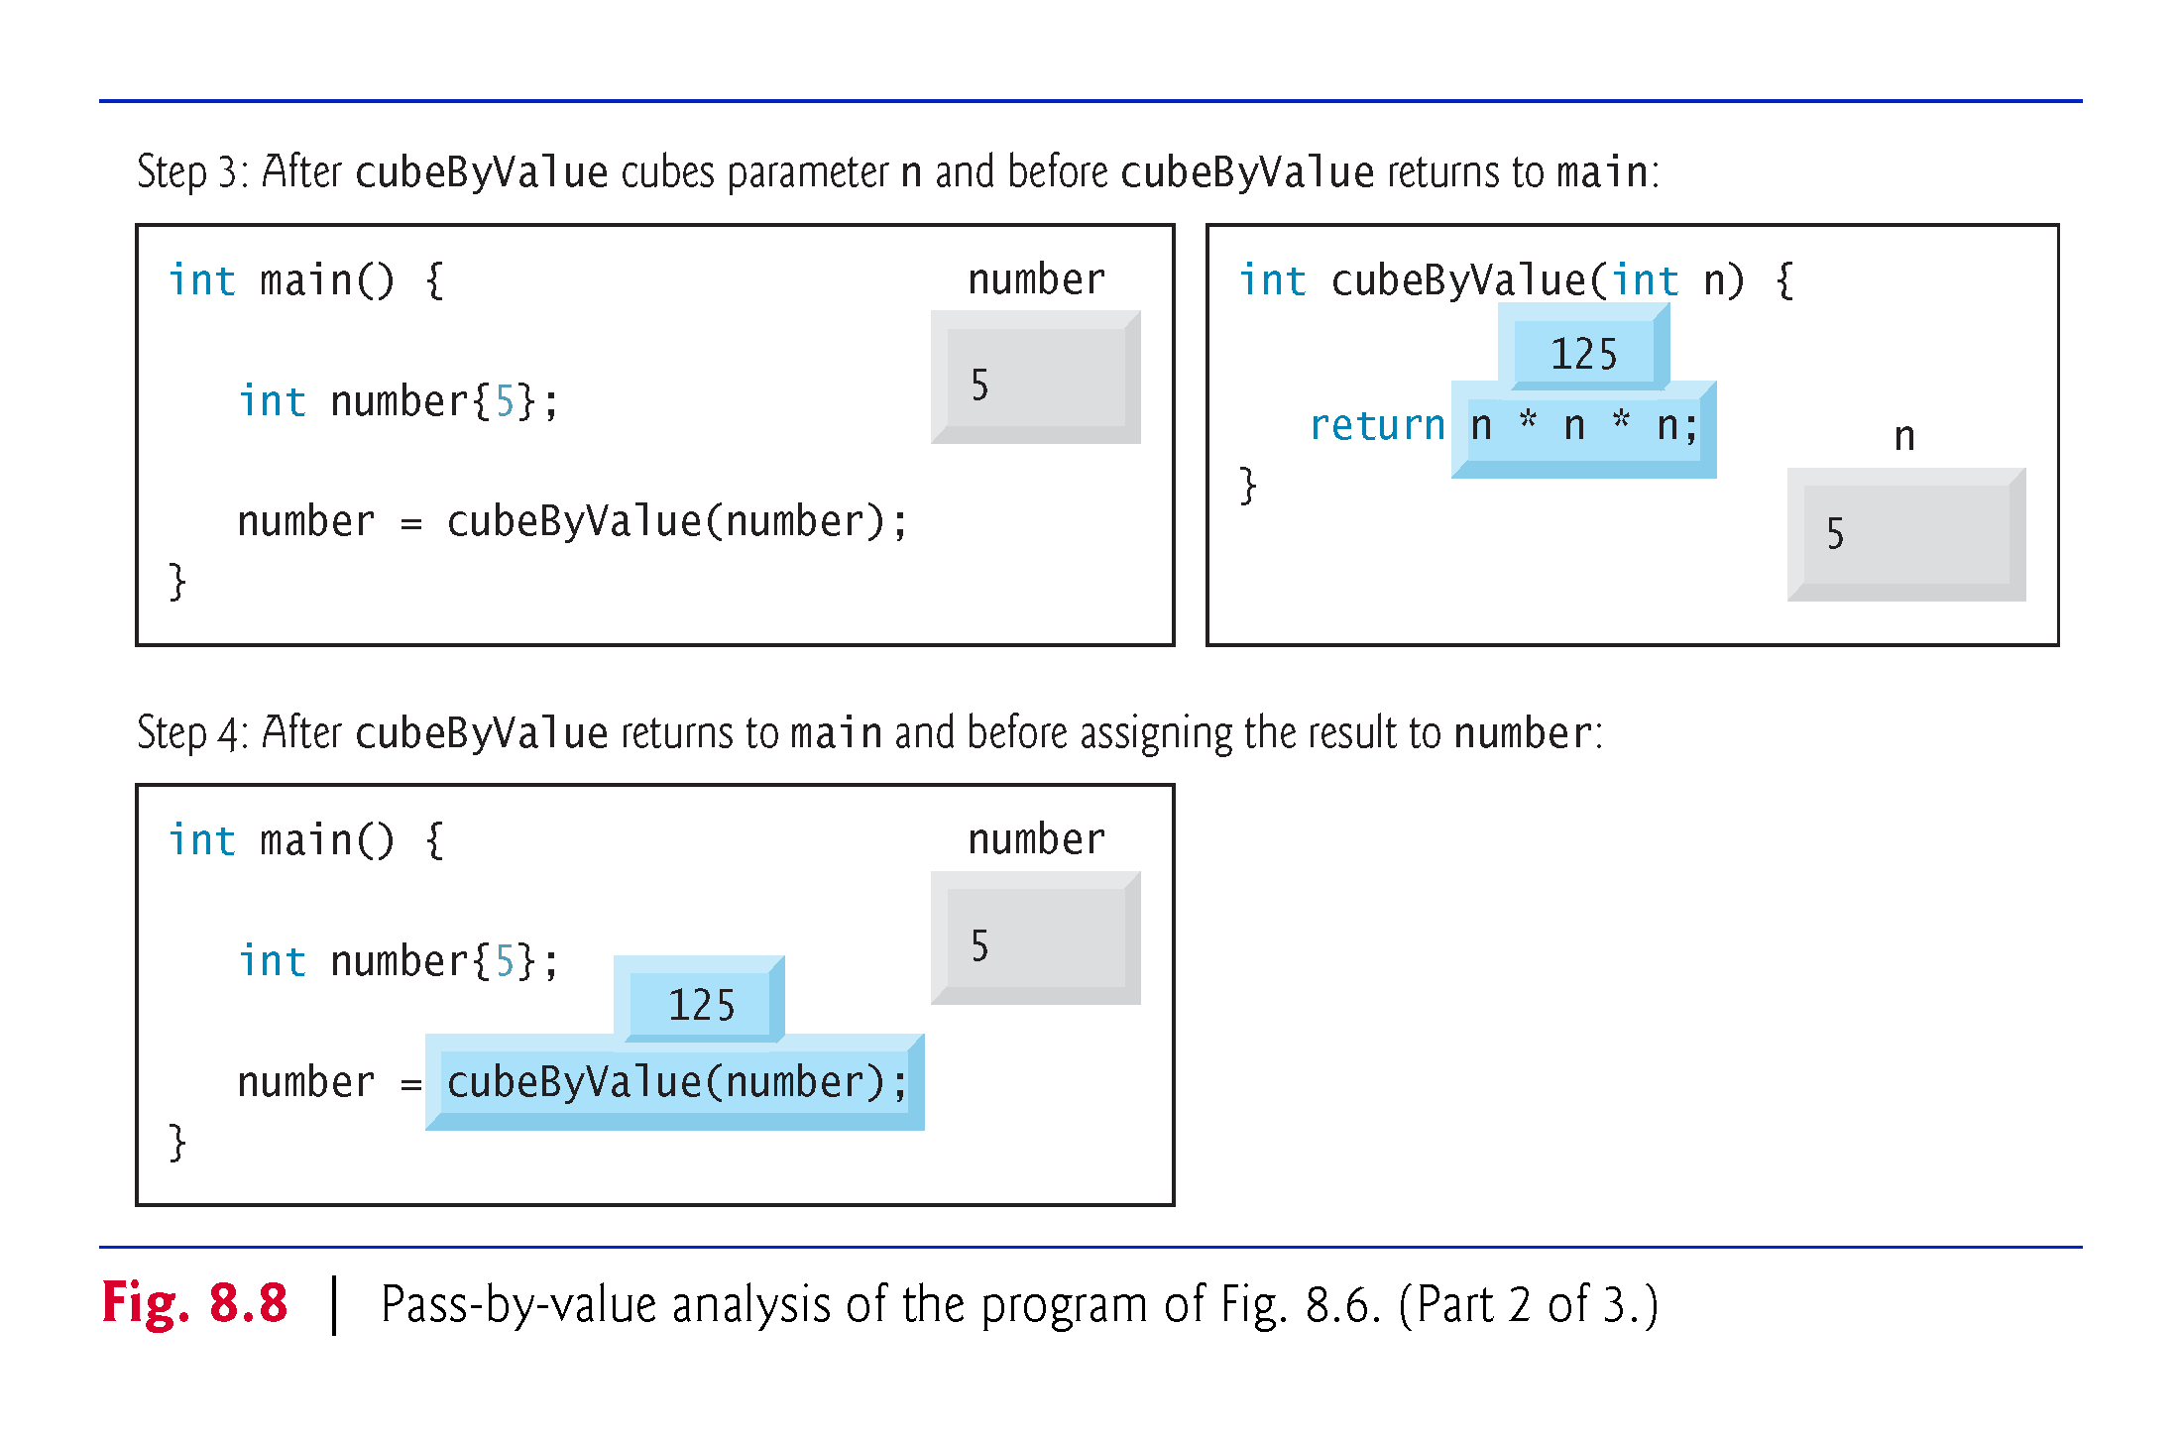

Slide 38
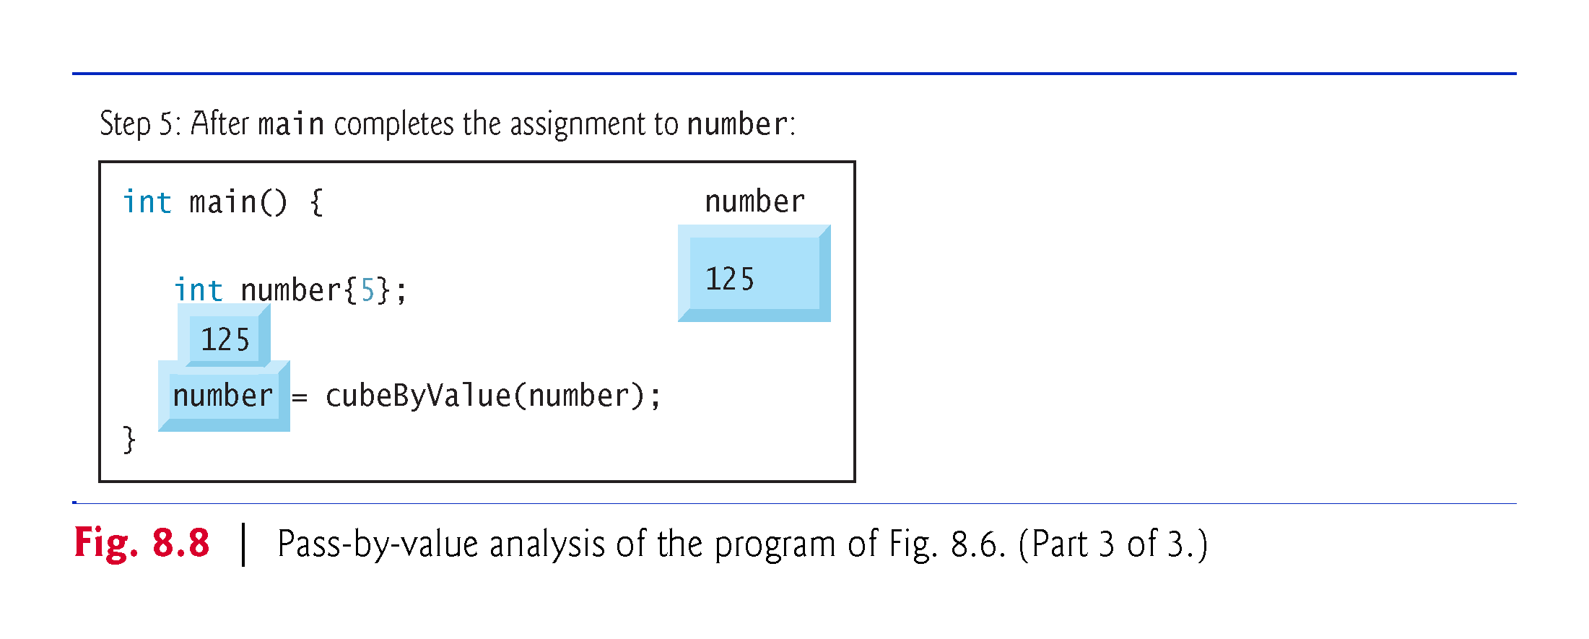

Slide 39
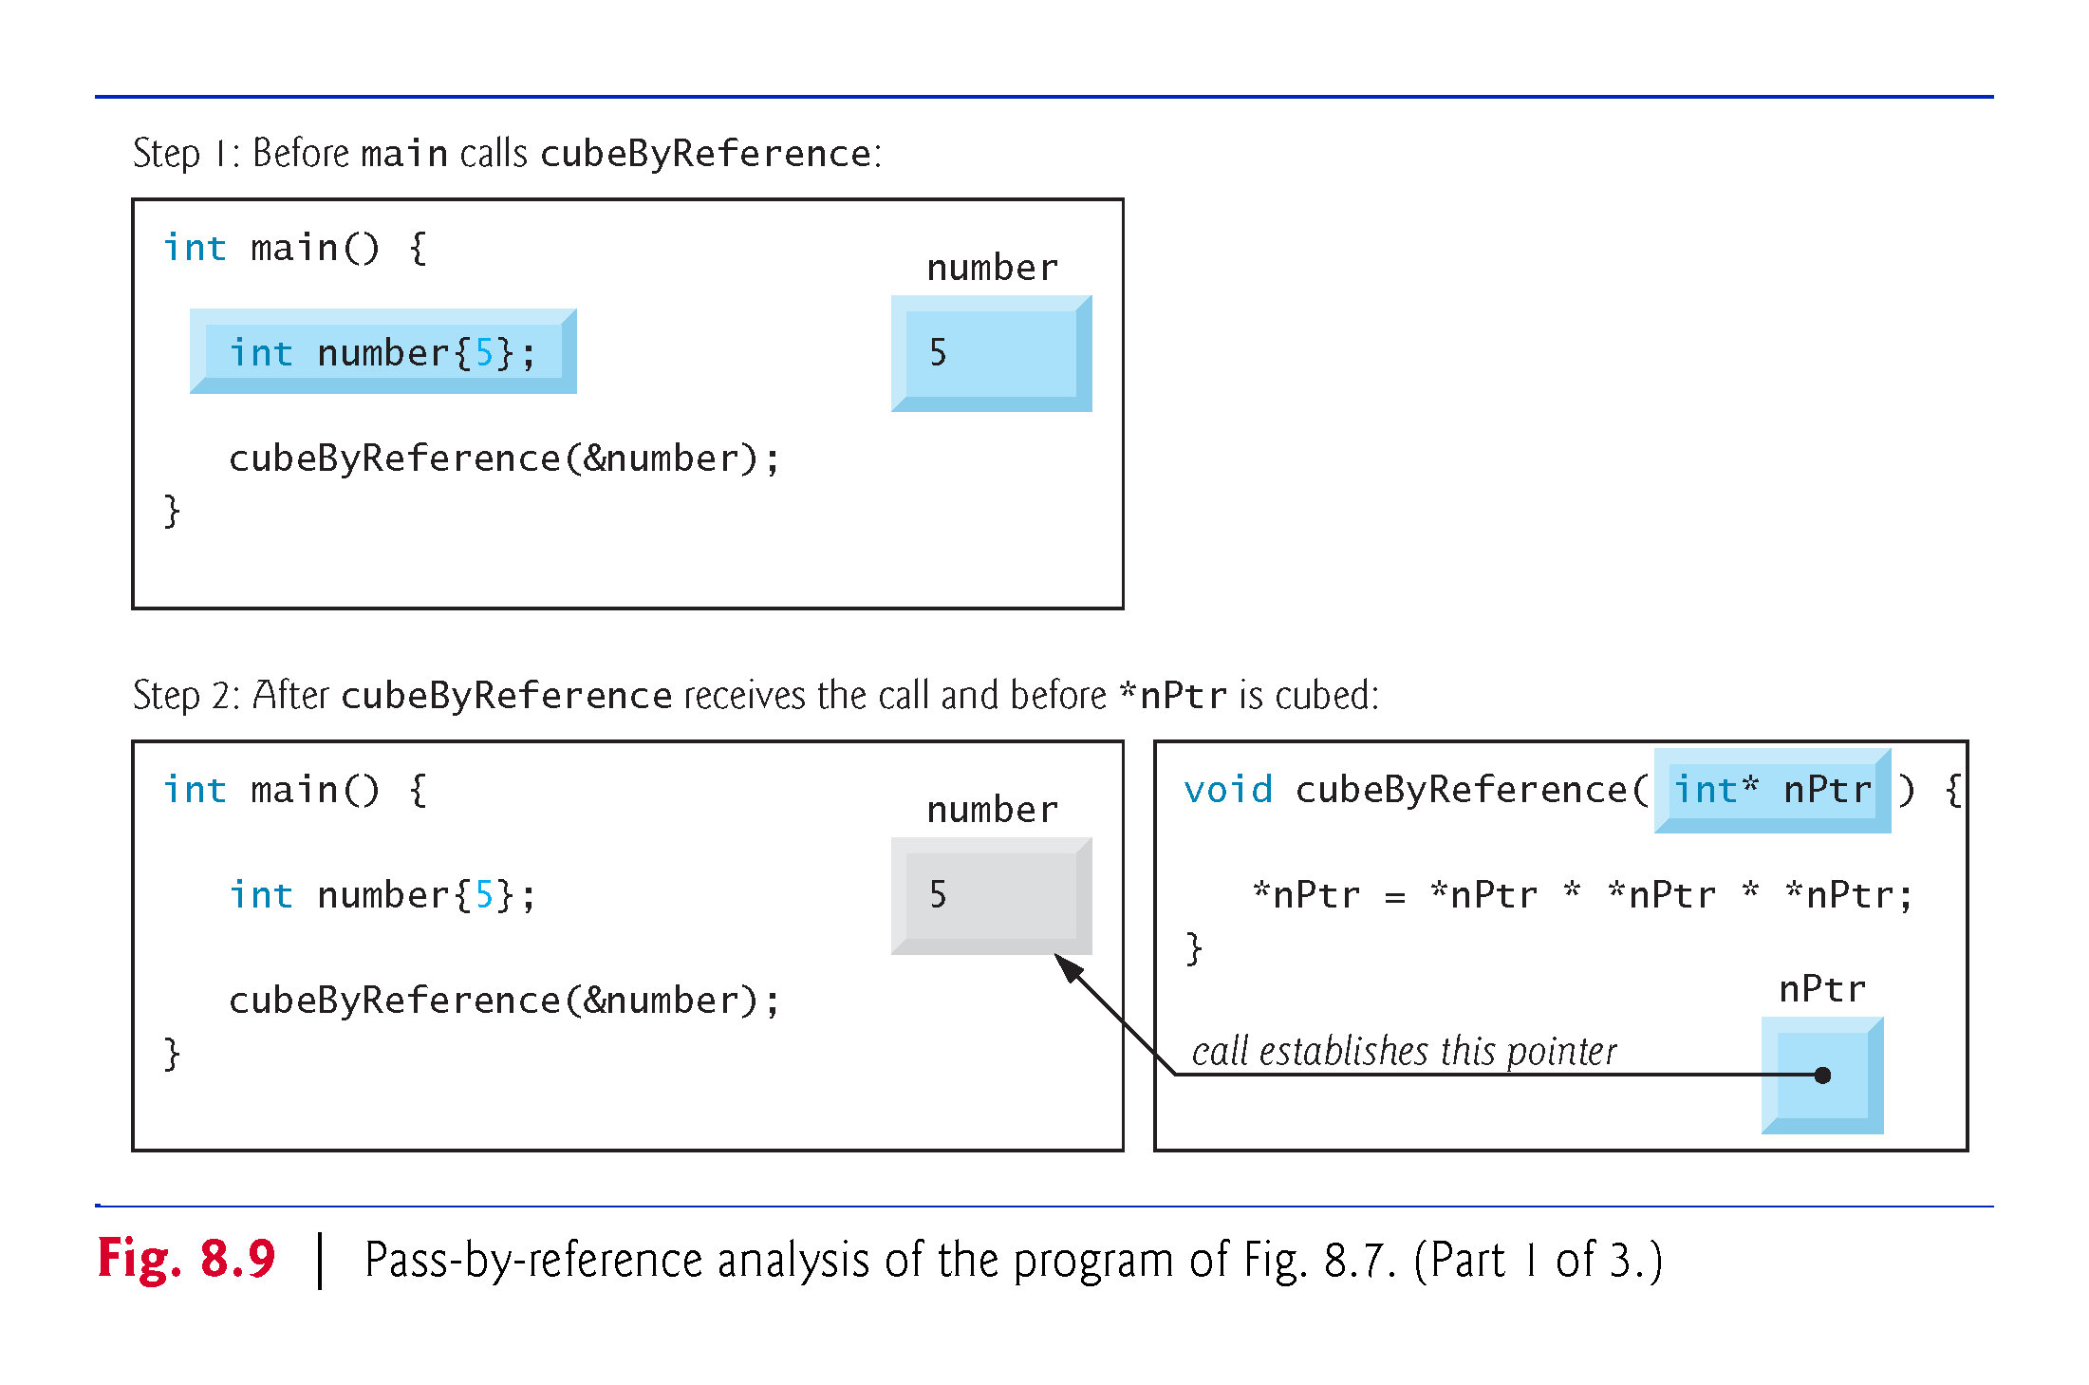

Slide 40
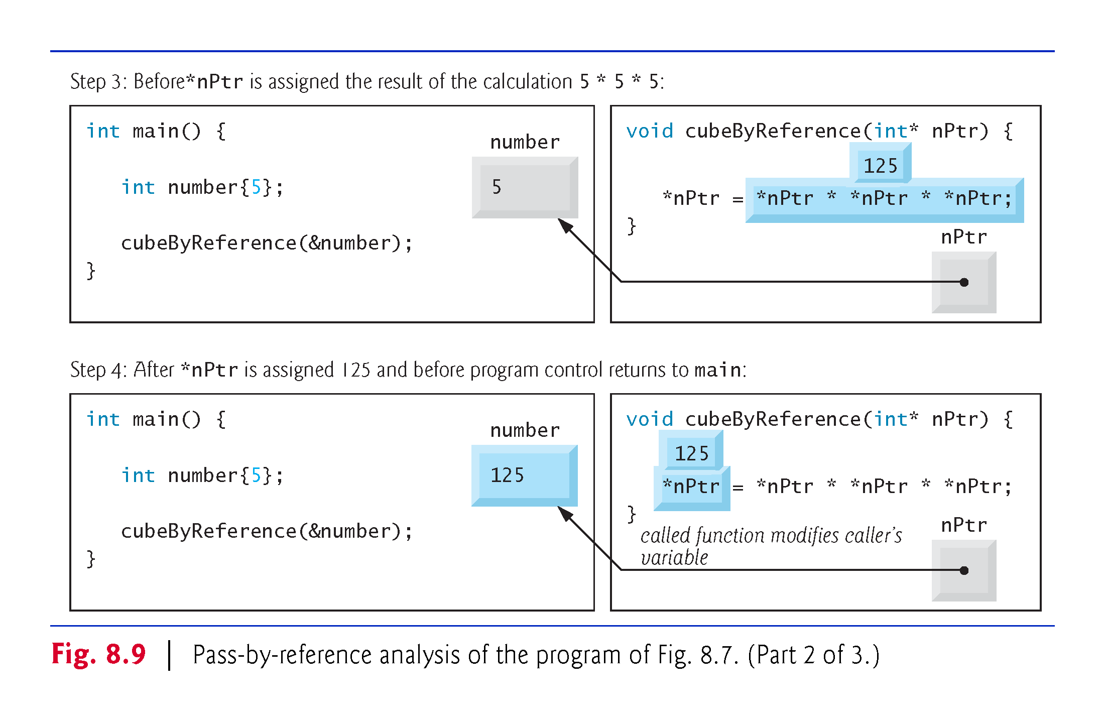

Slide 41
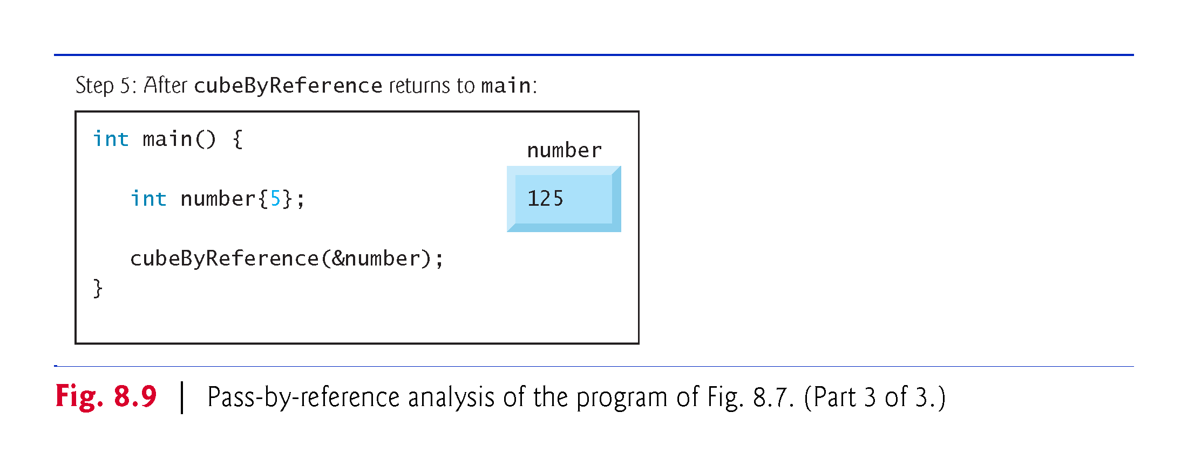

Slide 42
8.5 Built-In Arrays
Here we present built-in arrays, which are also fixed-size data structures.

Slide 43
8.5.1 Declaring and Accessing a Built-In Array
To specify the type of the elements and the number of elements required by a built-in array, use a declaration of the form:
type arrayName[arraySize];
The compiler reserves the appropriate amount of memory.
arraySize must be an integer constant greater than zero.
To reserve 12 elements for built-in array of ints named c, use the declaration
int c[12];
As with array objects, you use the subscript ([]) operator to access the individual elements of a built-in array.

Slide 44
8.5.2 Initializing Built-In Arrays
You can initialize the elements of a built-in array using an initializer list as in
int n[5]{50, 20, 30, 10, 40};
creates a built-in array of five ints and initializes them to the values in the initializer list.
If you provide fewer initializers
the number of elements, the remaining elements are value initialized—fundamental numeric types are set to 0, bools are set to false, pointers are set to nullptr and class objects are initialized by their default constructors.
If you provide too many initializers a compilation error occurs.

Slide 45
8.5.2 Initializing Built-In Arrays
If a built-in array’s size is omitted from a declaration with an initializer list, the compiler sizes the built-in array to the number of elements in the initializer list.
For example,
int n[]{50, 20, 30, 10, 40};
creates a five-element array.

Slide 46
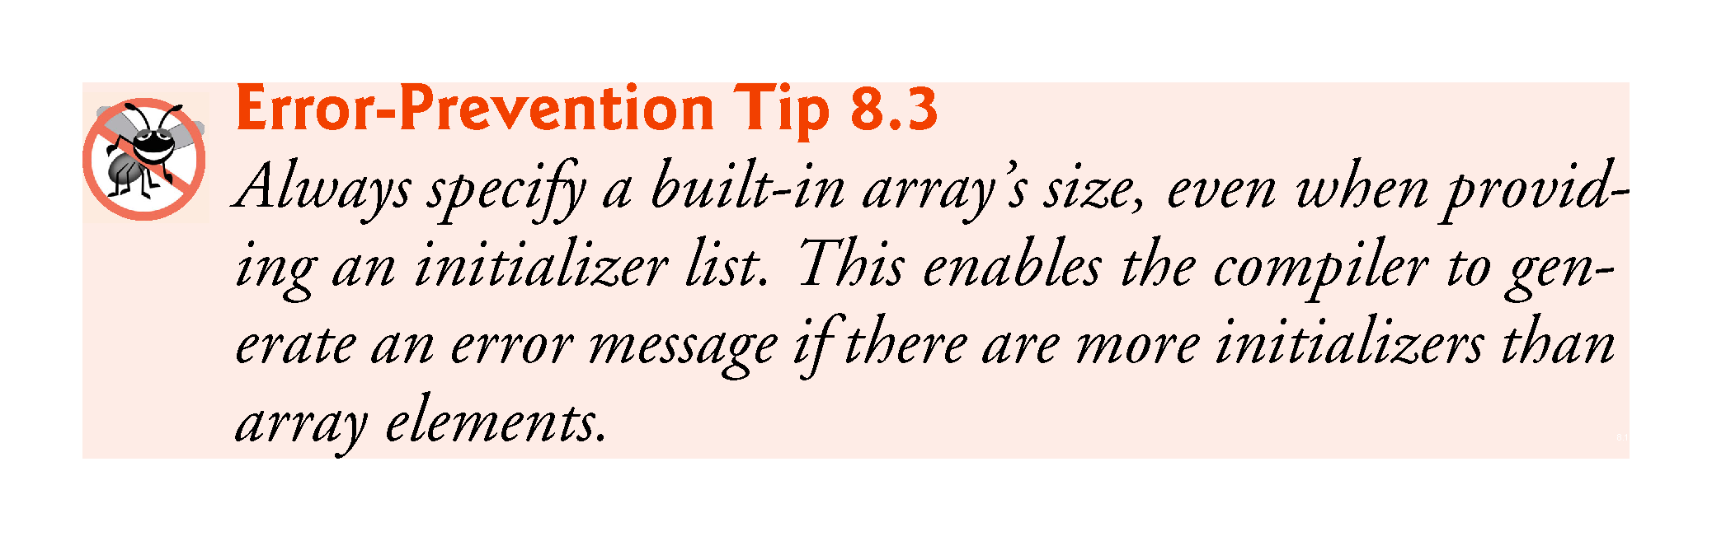

Slide 47
8.5.3 Passing Built-In Arrays to Functions
The value of a built-in array’s name is implicitly convertible to the address of the built-in array’s first element.
So arrayName is implicitly convertible to &arrayName[0].
You don’t need to take the address (&) of a built-in array to pass it to a function—you simply pass the built-in array’s name.
For built-in arrays, the called function can modify all the elements of a built-in array in the caller—unless the function precedes the corresponding built-in array parameter with const to indicate that the elements should not be modified.

Slide 48
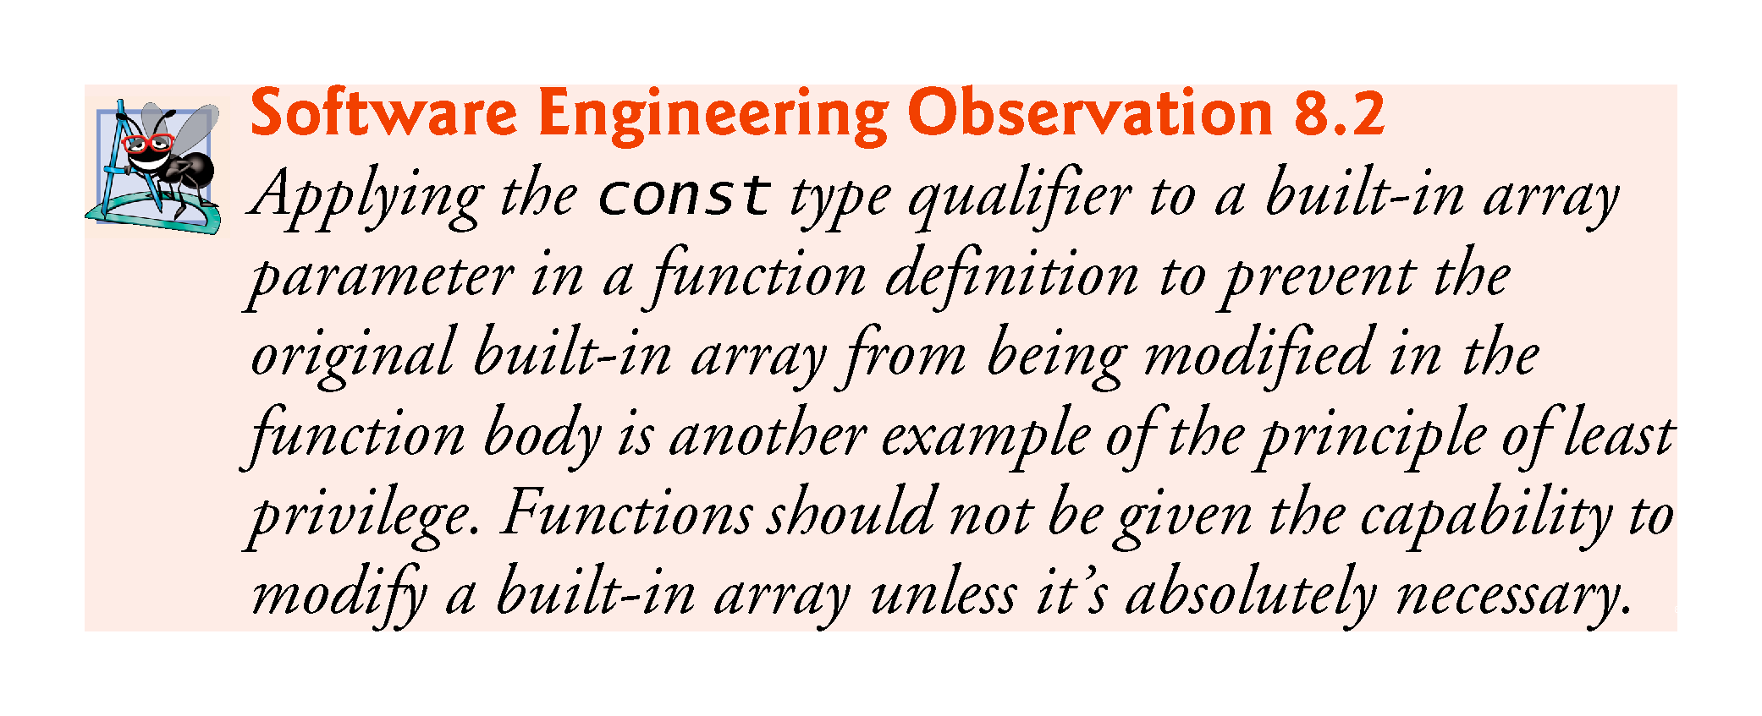

Slide 49
8.5.4 Declaring Built-In Array Parameters
You can declare a built-in array parameter in a function header, as follows:
int sumElements(const int values[], const size_t numberOfElements)
which indicates that the function’s first argument should be a one-dimensional built-in array of ints that should not be modified by the function.
The preceding header can also be written as:
int sumElements(const int* values, const size_t numberOfElements)

Slide 50
8.5.4 Declaring Built-In Array Parameters
The compiler does not differentiate between a function that receives a pointer and a function that receives a built-in array.
The function must “know” when it’s receiving a built-in array or simply a single variable that’s being passed by reference.
When the compiler encounters a function parameter for a one-dimensional built-in array of the form const int values[], the compiler converts the parameter to the pointer notation const int* values.
These forms of declaring a one-dimensional built-in array parameter are interchangeable.

Slide 51
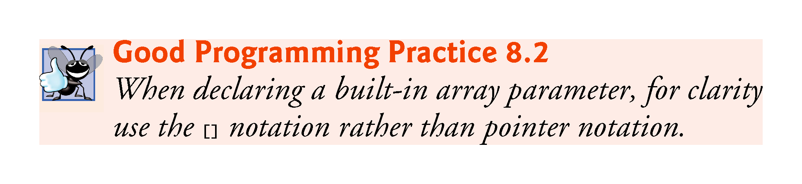

Slide 52
8.5.5 C++11: Standard Library Functions begin and end
In Section 7.7, we showed how to sort an array object with the C++ Standard Library function sort.
We sorted an array of strings called colors as follows:
// sort contents of colors
sort(colors.begin(), colors.end());
The array class’s begin and end functions specified that the entire array should be sorted.

Slide 53
8.5.5 C++11: Standard Library Functions begin and end
Function sort (and many other C++ Standard Library functions) can also be applied to built-in arrays.
For example, to sort the built-in array n shown earlier in this section, you can write:
// sort contents of built-in array n
sort(begin(n), end(n));
C++11’s new begin and end functions (from header <iterator>) each receive a built-in array as an argument and return a pointer that can be used to represent ranges of elements to process in C++ Standard Library functions like sort.

Slide 54
8.5.6 Built-In Array Limitations
Built-in arrays have several limitations:
They cannot be compared using the relational and equality operators—you must use a loop to compare two built-in arrays element by element.
They cannot be assigned to one another.
They don’t know their own size—a function that processes a built-in array typically receives both the built-in array’s name and its size as arguments.
They don’t provide automatic bounds checking—you must ensure that array-access expressions use subscripts that are within the built-in array’s bounds.

Slide 55
8.5.7 Built-In Arrays Sometimes Are Required
There are cases in which built-in arrays must be used, such as processing a program’s command-line arguments.
You supply command-line arguments to a program by placing them after the program’s name when executing it from the command line. Such arguments typically pass options to a program.

Slide 56
8.5.7 Built-In Arrays Sometimes Are Required
On a Windows computer, the command
dir /p
uses the /p argument to list the contents of the current directory, pausing after each screen of information.
On Linux or OS X, the following command uses the -la argument to list the contents of the current directory with details about each file and directory:
ls -la

Slide 57
8.6 Using const with Pointers
Many possibilities exist for using (or not using) const with function parameters.
Principle of least privilege
Always give a function enough access to the data in its parameters to accomplish its specified task, but no more.

Slide 58
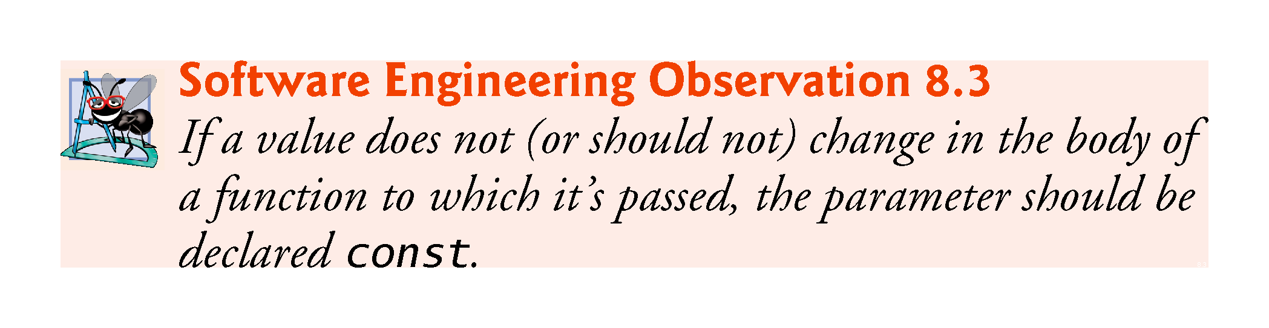

Slide 59
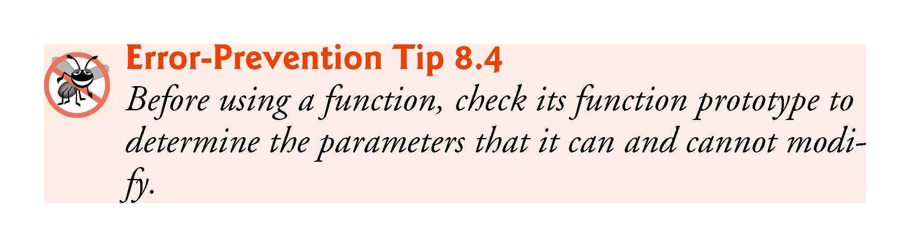

Slide 60
8.6 Using const with Pointers (cont.)
There are four ways to pass a pointer to a function
a nonconstant pointer to nonconstant data
a nonconstant pointer to constant data (Fig. 8.10)
a constant pointer to nonconstant data (Fig. 8.11)
a constant pointer to constant data (Fig. 8.12)
Each combination provides a different level of access privilege.

Slide 61
8.6.1 Nonconstant Pointer to Nonconstant Data
The highest access is granted by a nonconstant pointer to nonconstant data
The data can be modified through the dereferenced pointer
The pointer can be modified to point to other data.
Such a pointer’s declaration (e.g., int* countPtr) does not include const.

Slide 62
8.6.2 Nonconstant Pointer to Constant Data
Nonconstant pointer to constant data
A pointer that can be modified to point to any item of the appropriate type
The data to which it points cannot be modified through that pointer
Sample declaration:
const int* countPtr;
Read from right to left as “countPtr is a pointer to an integer constant” or more precisely, “countPtr is a non-constant pointer to an integer constant.”
Figure 8.10 demonstrates GNU C++’s compilation error message produced when attempting to compile a function that receives a nonconstant pointer to constant data, then tries to use that pointer to modify the data.

Slide 63
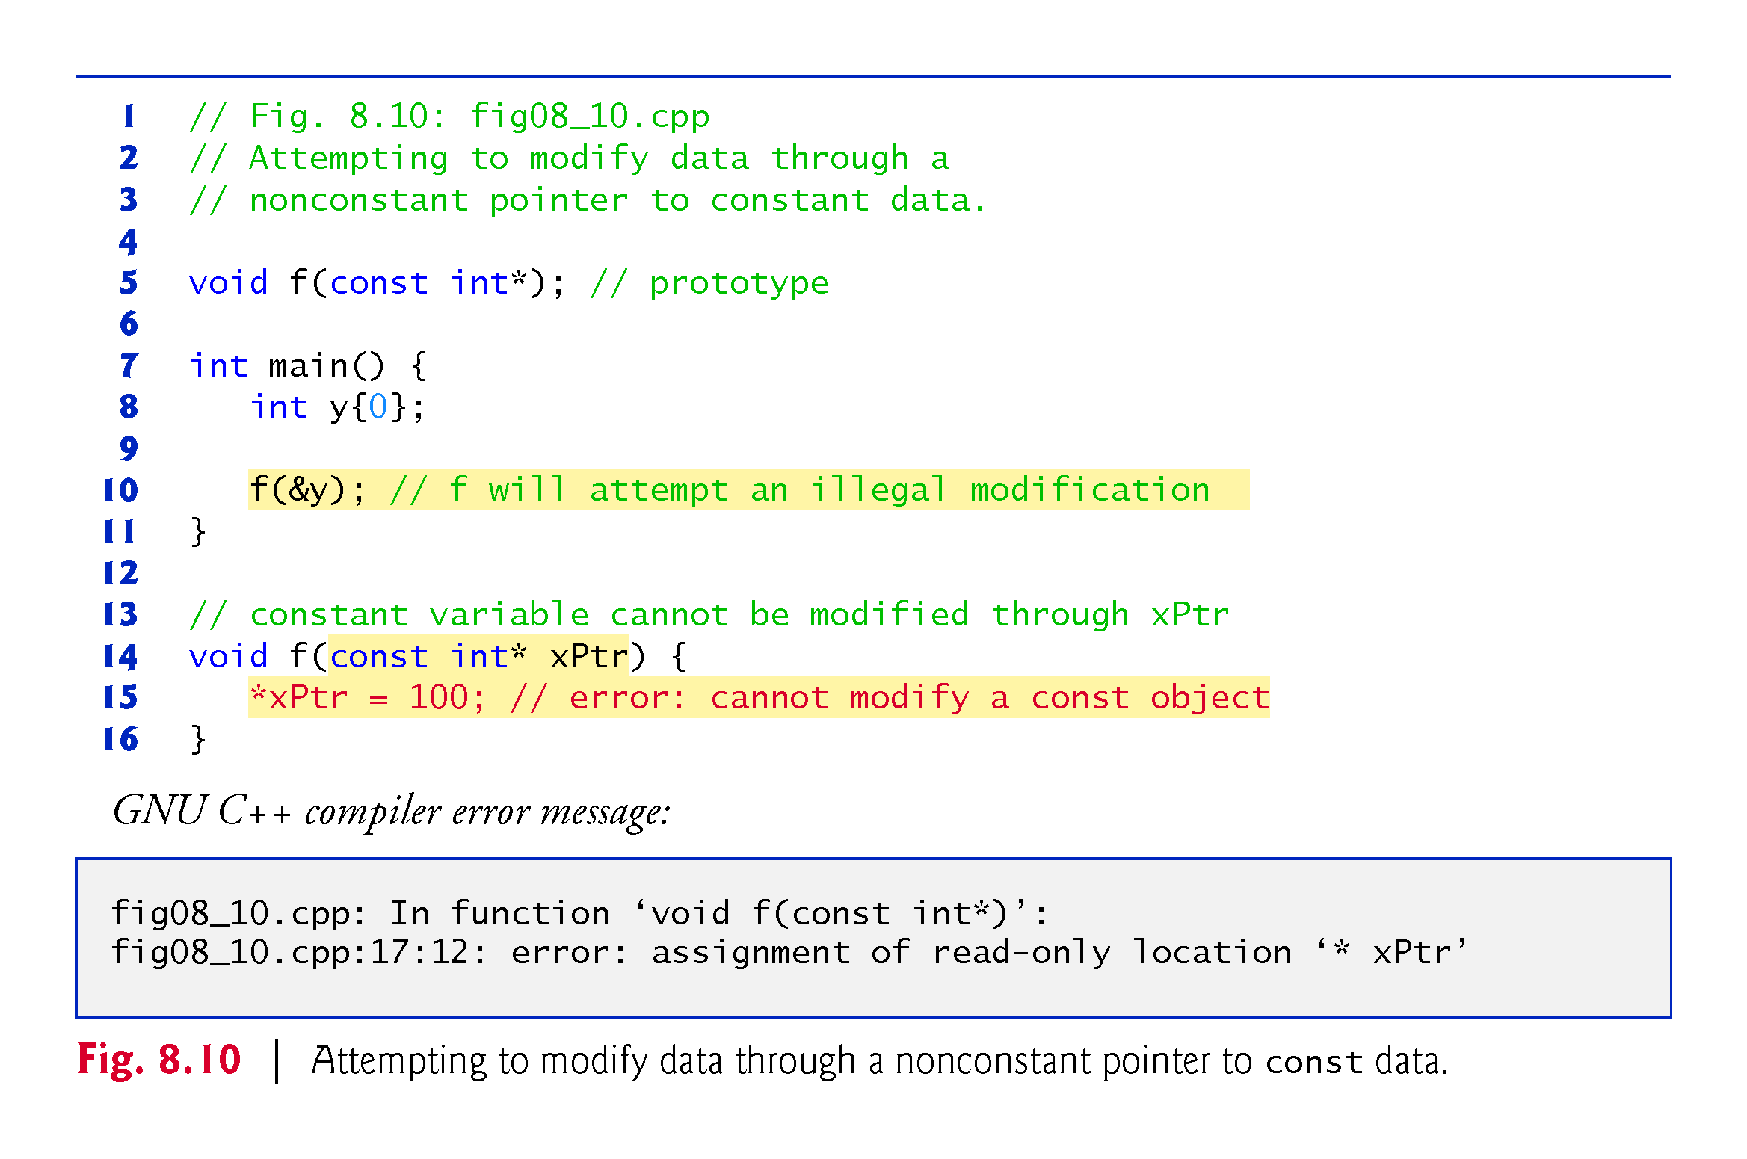

Slide 64
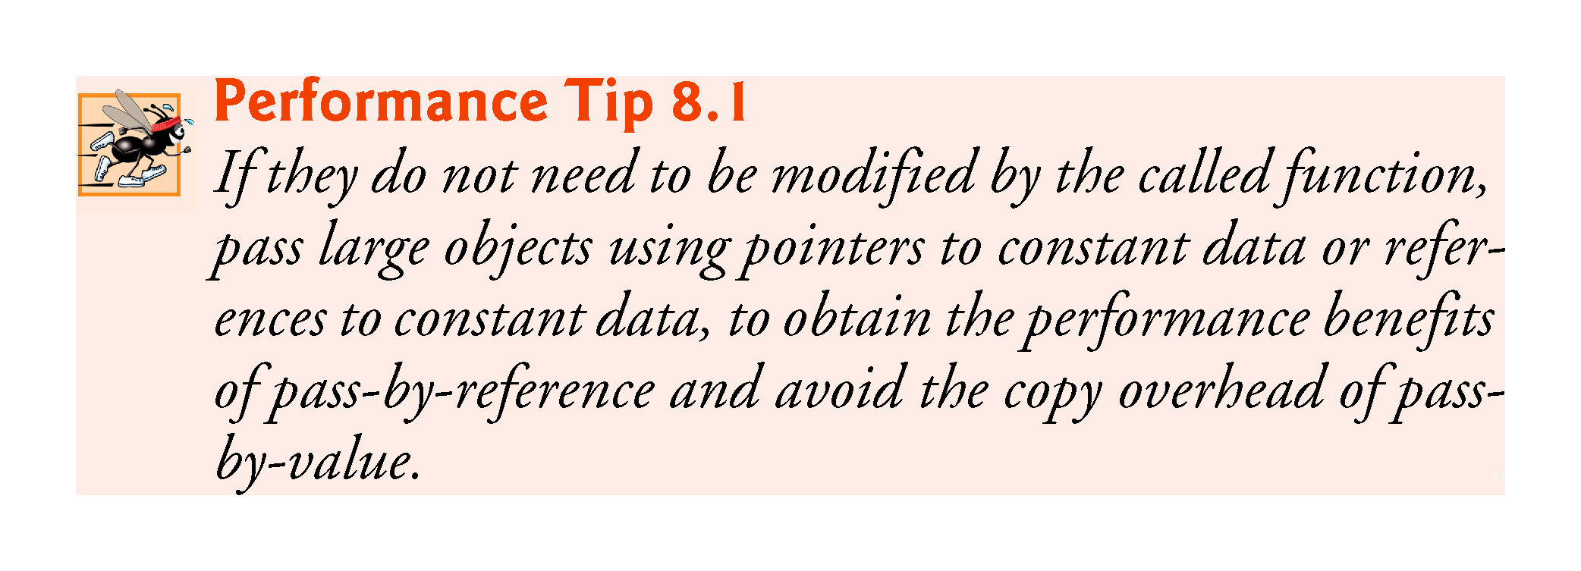

Slide 65
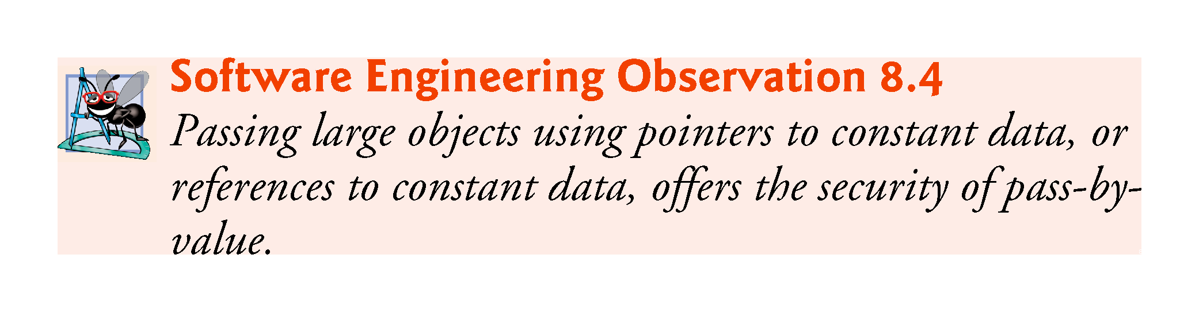

Slide 66
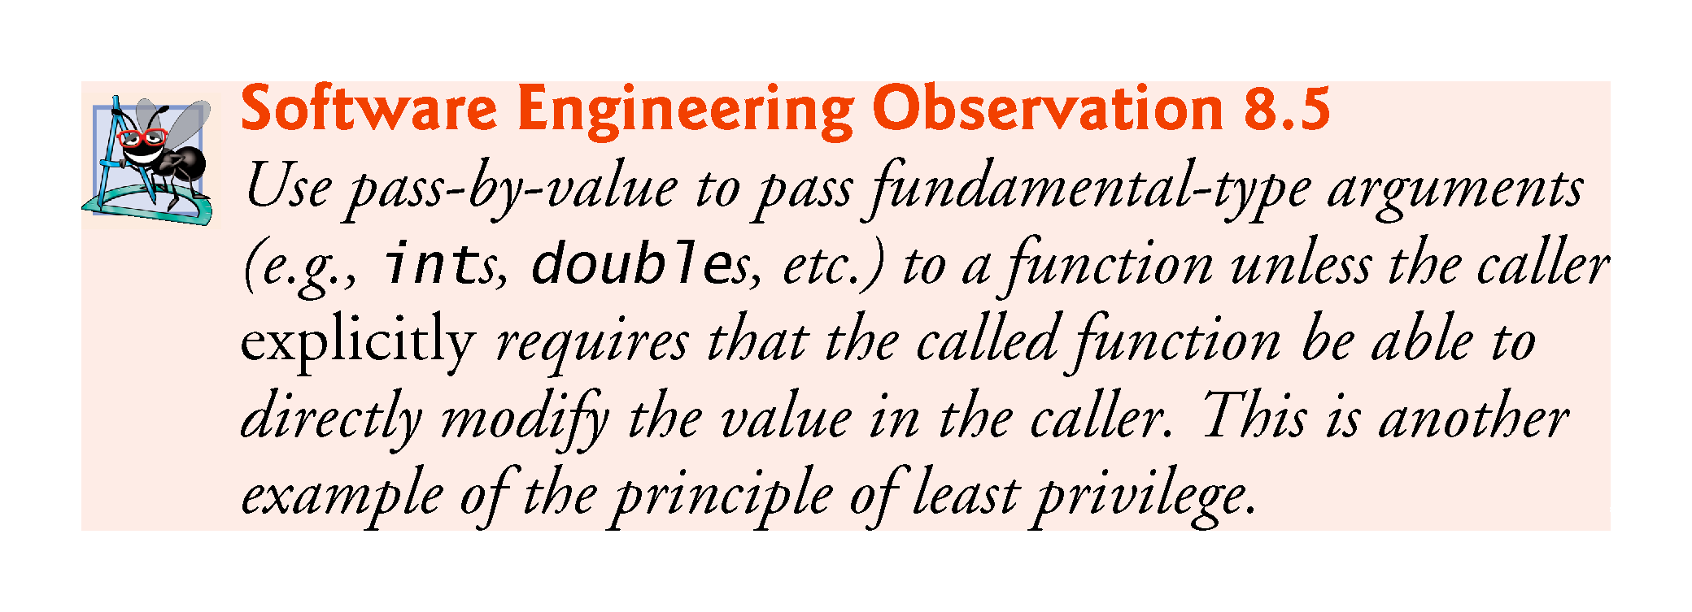

Slide 67
8.6.3 Constant Pointer to Nonconstant Data
Constant pointer to nonconstant data
always points to the same memory location
the data at that location can be modified through the pointer
Pointers that are declared const must be initialized when they’re declared.
If the pointer is a function parameter, it’s initialized with a pointer that’s passed to the function.
Fig. 8.11 attempts to modify a constant pointer.

Slide 68
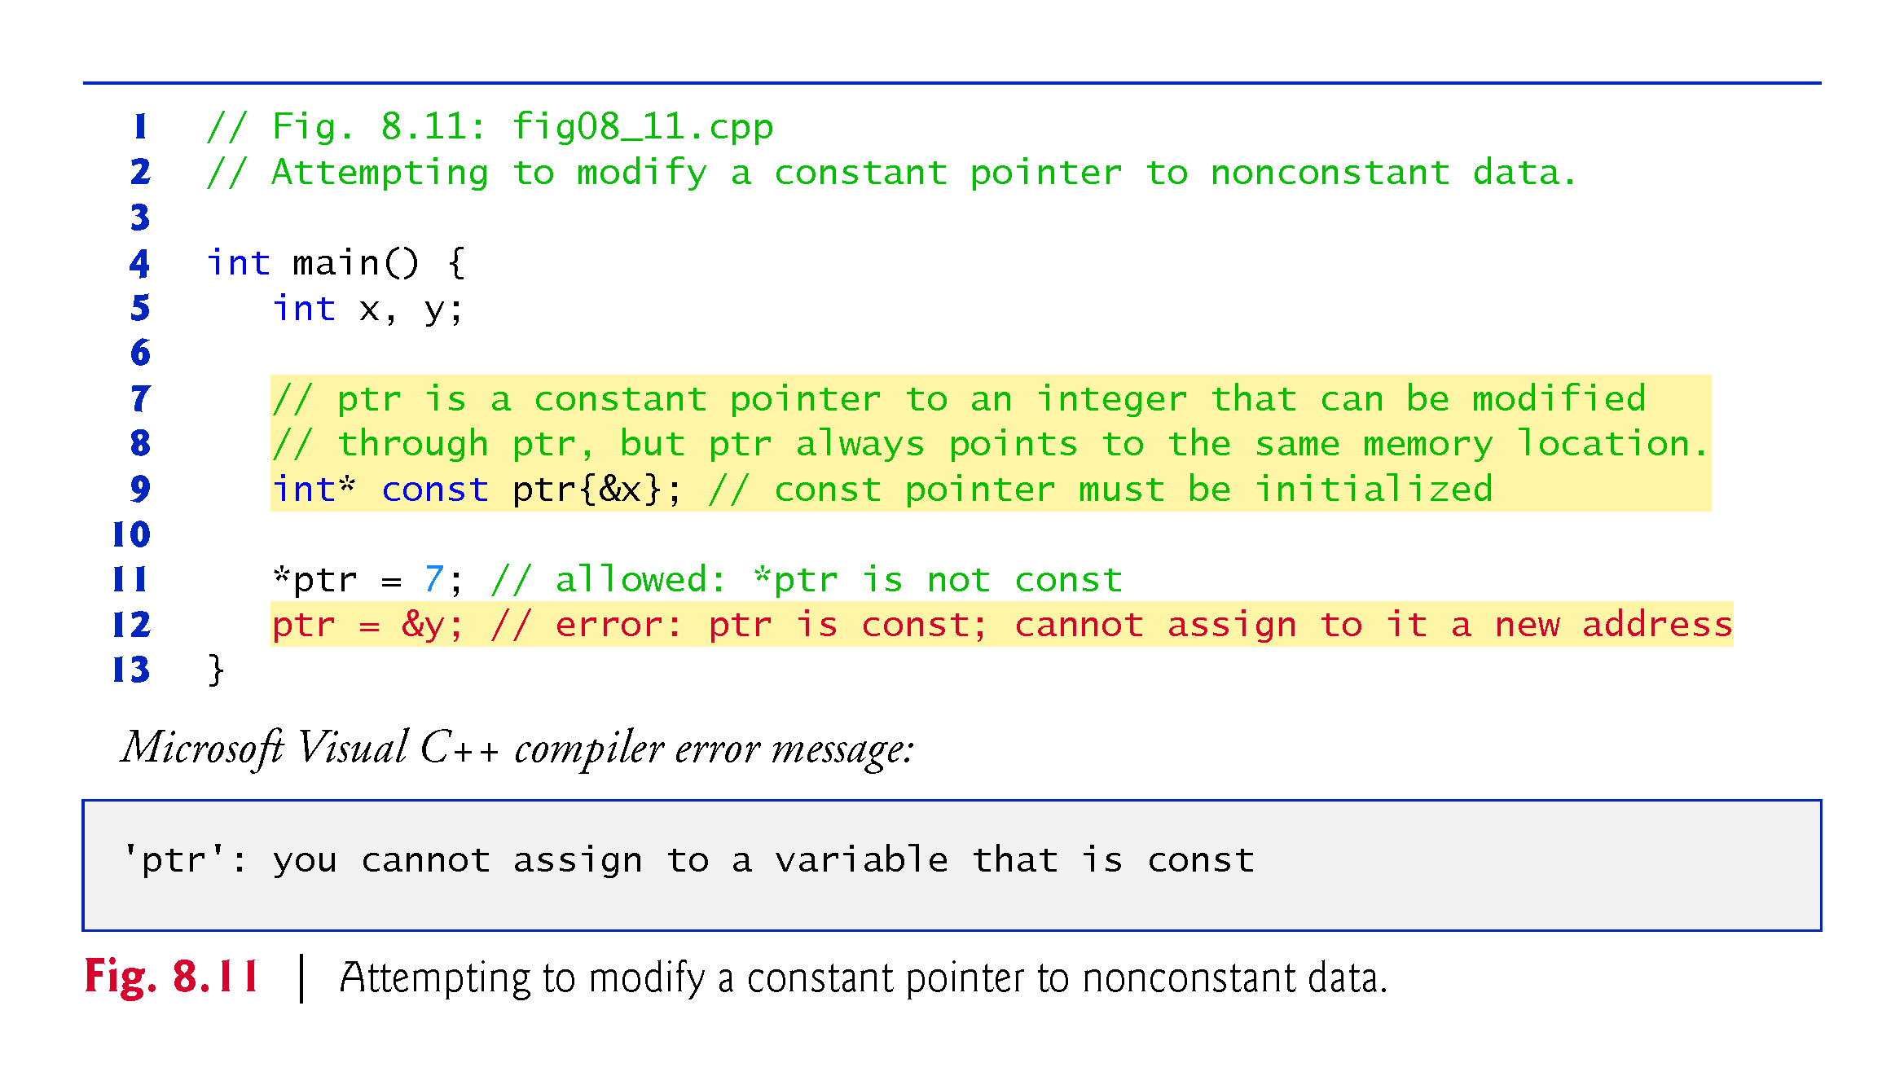

Slide 69
8.6.4 Constant Pointer to Constant Data
The minimum access privilege is granted by a constant pointer to constant data.
Such a pointer always points to the same memory location
The data at that location cannot be modified via the pointer.
This is how a built-in array should be passed to a function that only reads from the built-in array, using array subscript notation, and does not modify the built-in array.
const int* const
Read from right to left as “ptr is a constant pointer to an integer constant.”
Fig. 8.12 shows the Xcode LLVM compiler’s error messages that are generated when an attempt is made to modify the data to which ptr points and when an attempt is made to modify the address stored in the pointer variable—these show up on the lines of code with the errors in the Xcode text editor.

Slide 70
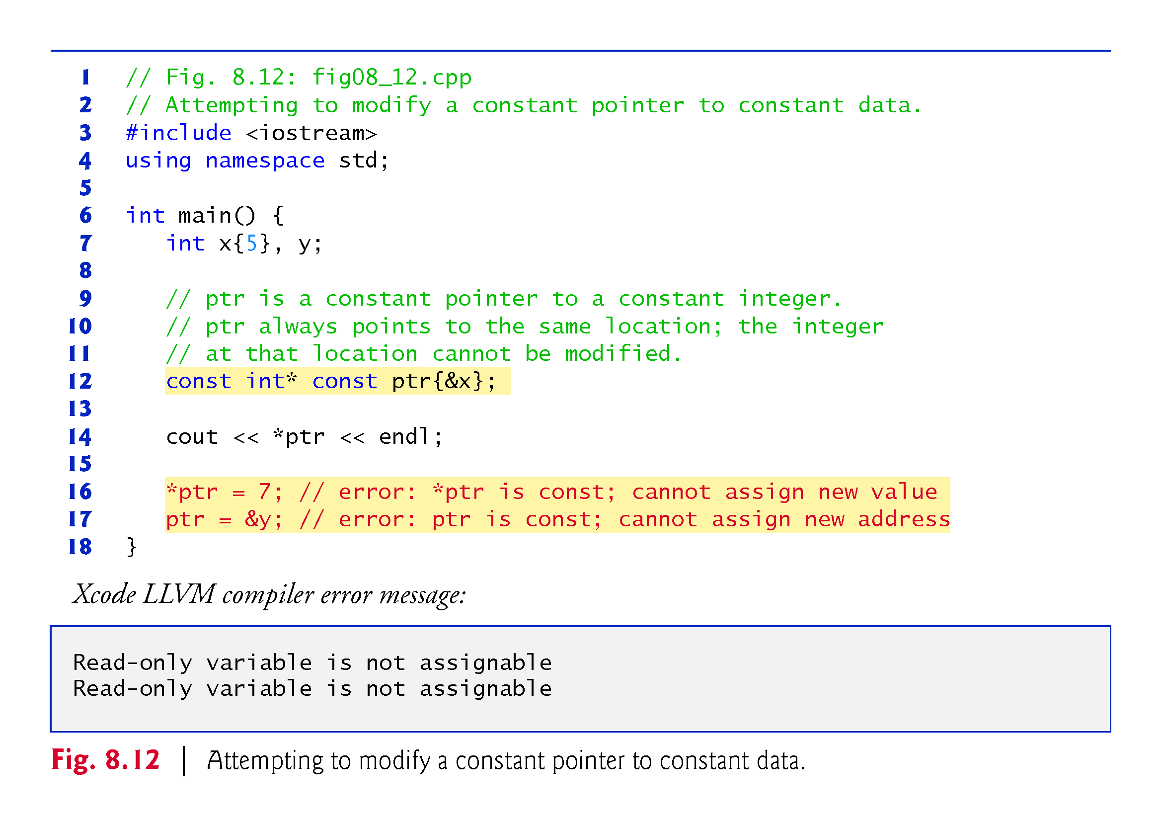

Slide 71
8.7 sizeof Operator
The unary operator sizeof determines the size in bytes of a built-in array or of any other data type, variable or constant during program compilation.
When applied to a built-in array’s name, as in Fig. 8.13, the sizeof operator returns the total number of bytes in the built-in array as a value of type size_t.
When applied to a pointer parameter in a function that receives a built-in array as an argument, the sizeof operator returns the size of the pointer in bytes—not the built-in array’s size.

Slide 72
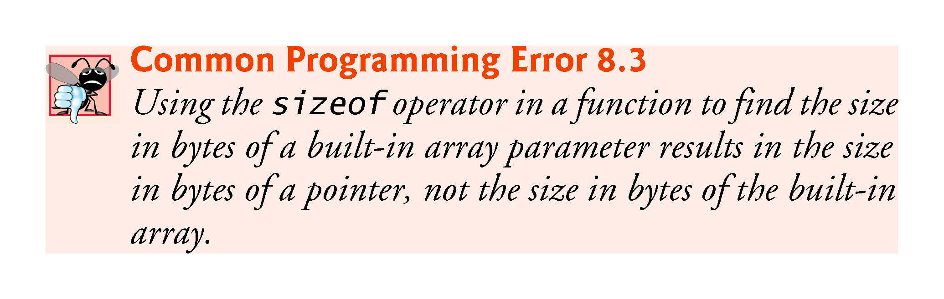

Slide 73
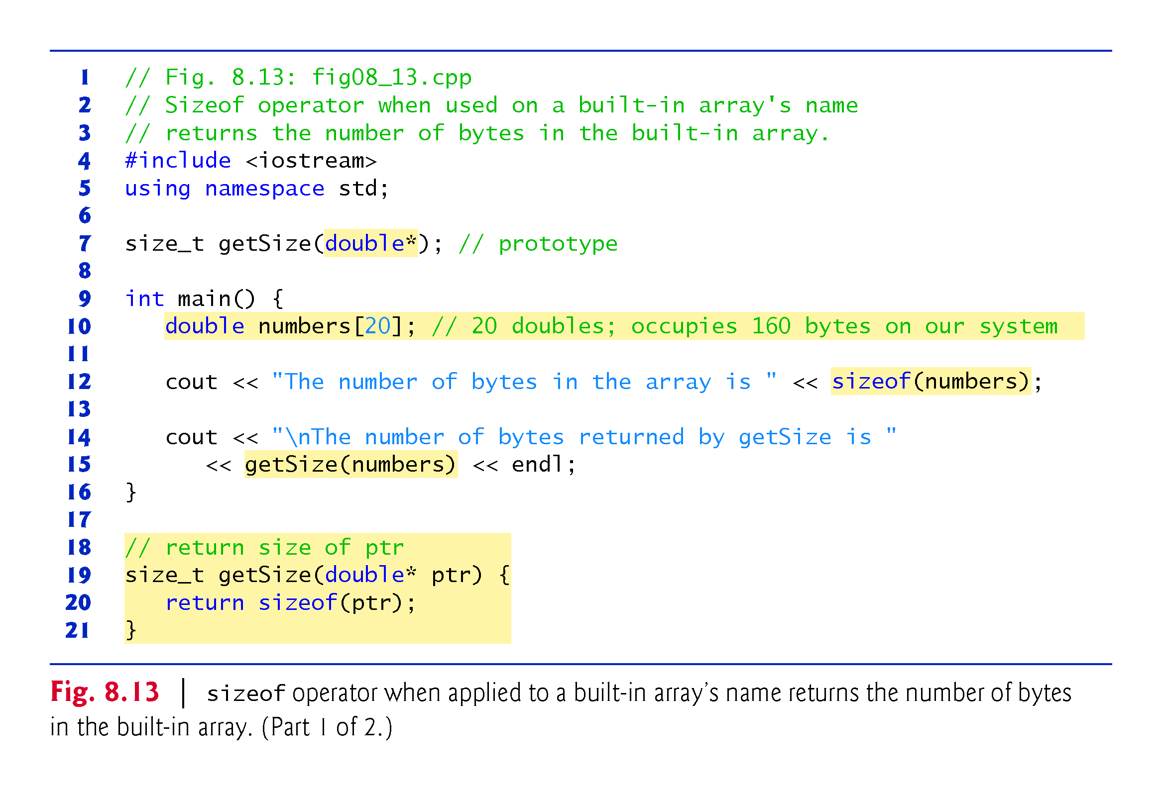

Slide 74
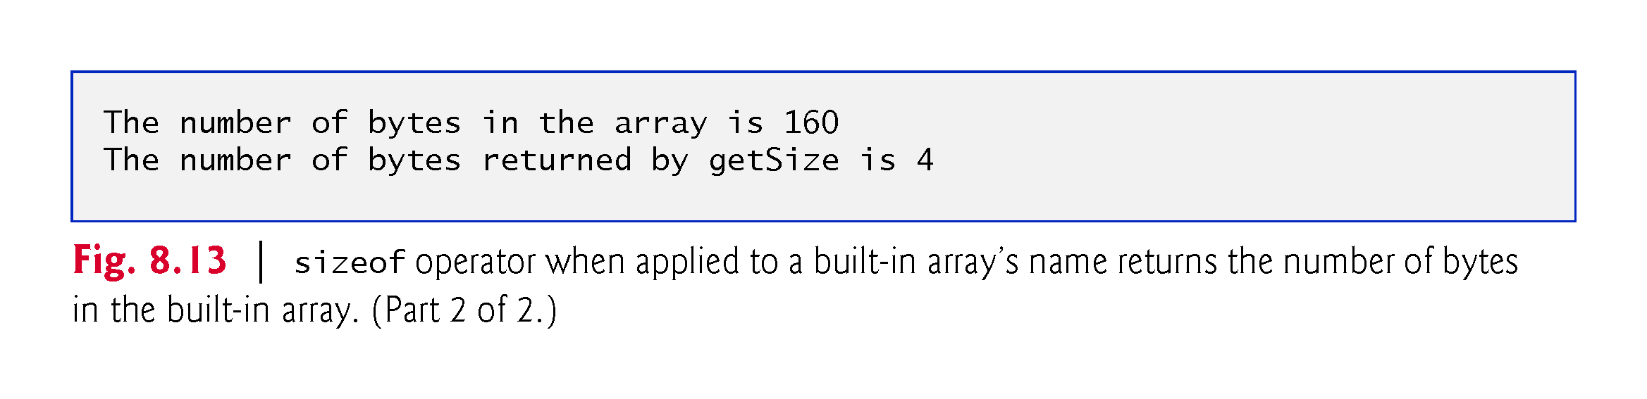

Slide 75
8.7 sizeof Operator (cont.)
To determine the number of elements in the built-in array numbers, use the following expression (which is evaluated at compile time) :
sizeof numbers / sizeof(numbers[0])
The expression divides the number of bytes in numbers by the number of bytes in the built-in array’s zeroth element.

Slide 76
8.7 sizeof Operator (cont.)
Figure 8.14 uses sizeof to calculate the number of bytes used to store many of the standard data types.
The output was produced using the default settings in Xcode 7.2 on Mac OS X.
Type sizes are platform dependent.

Slide 77
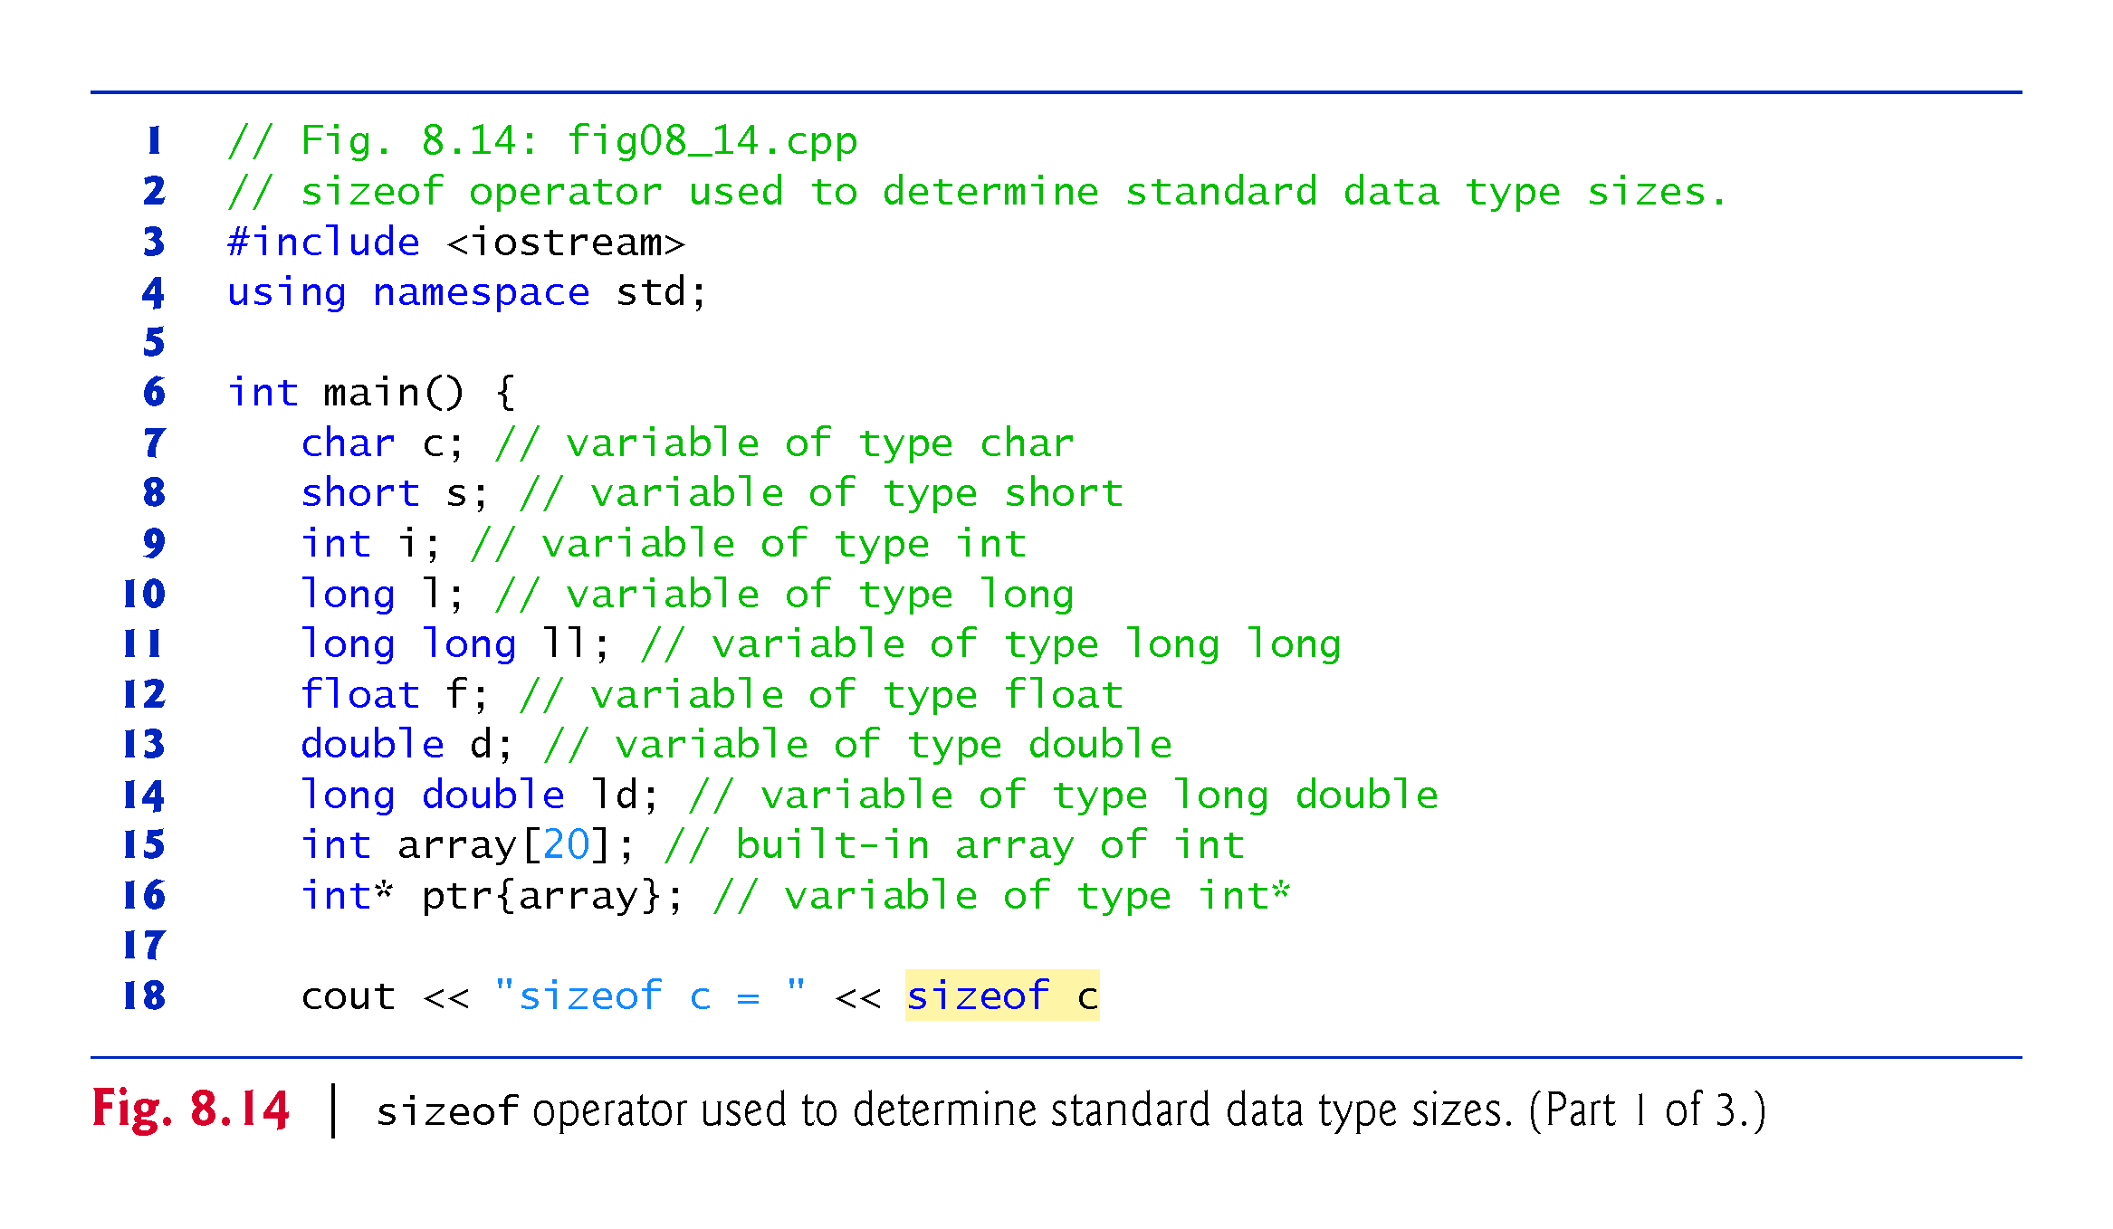

Slide 78
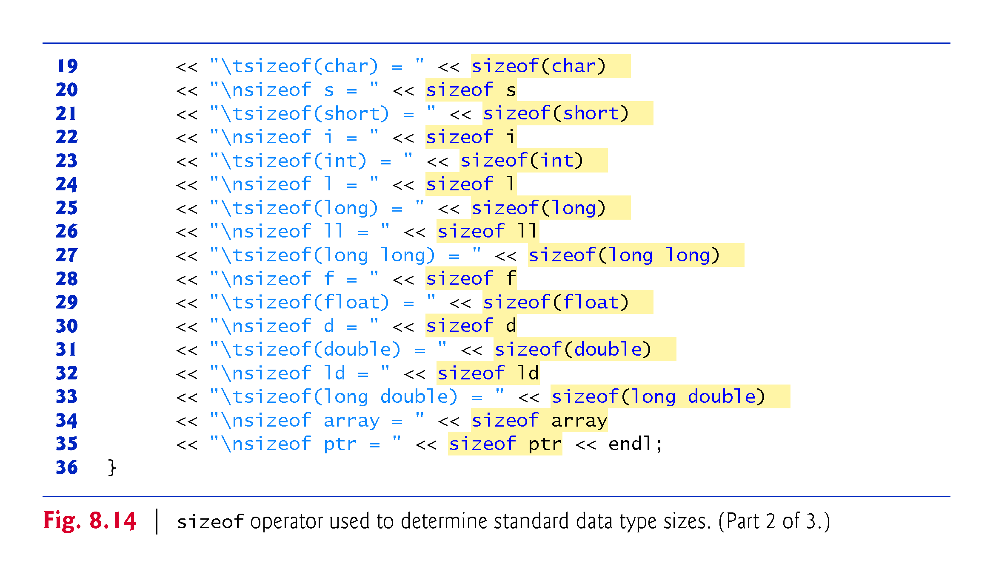

Slide 79
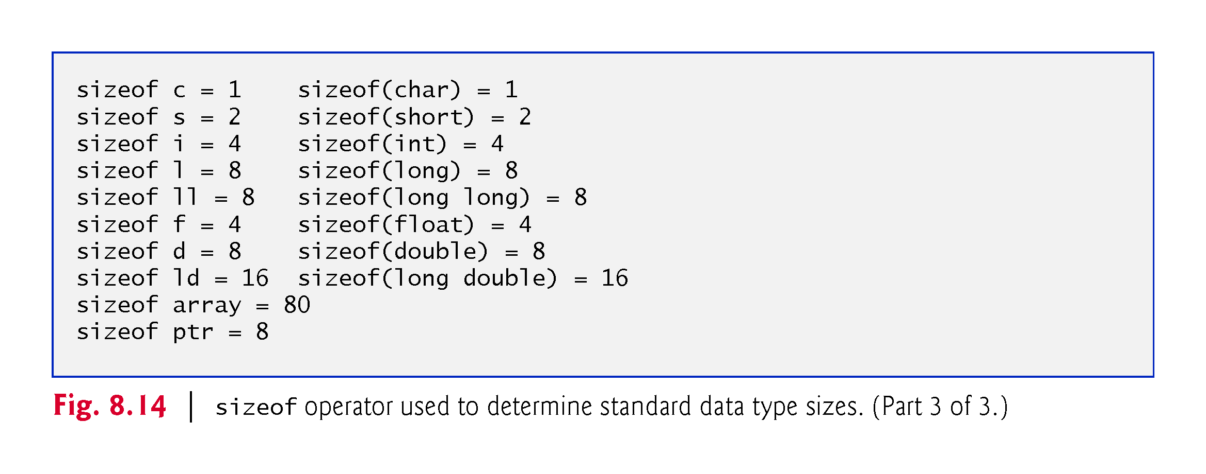

Slide 80
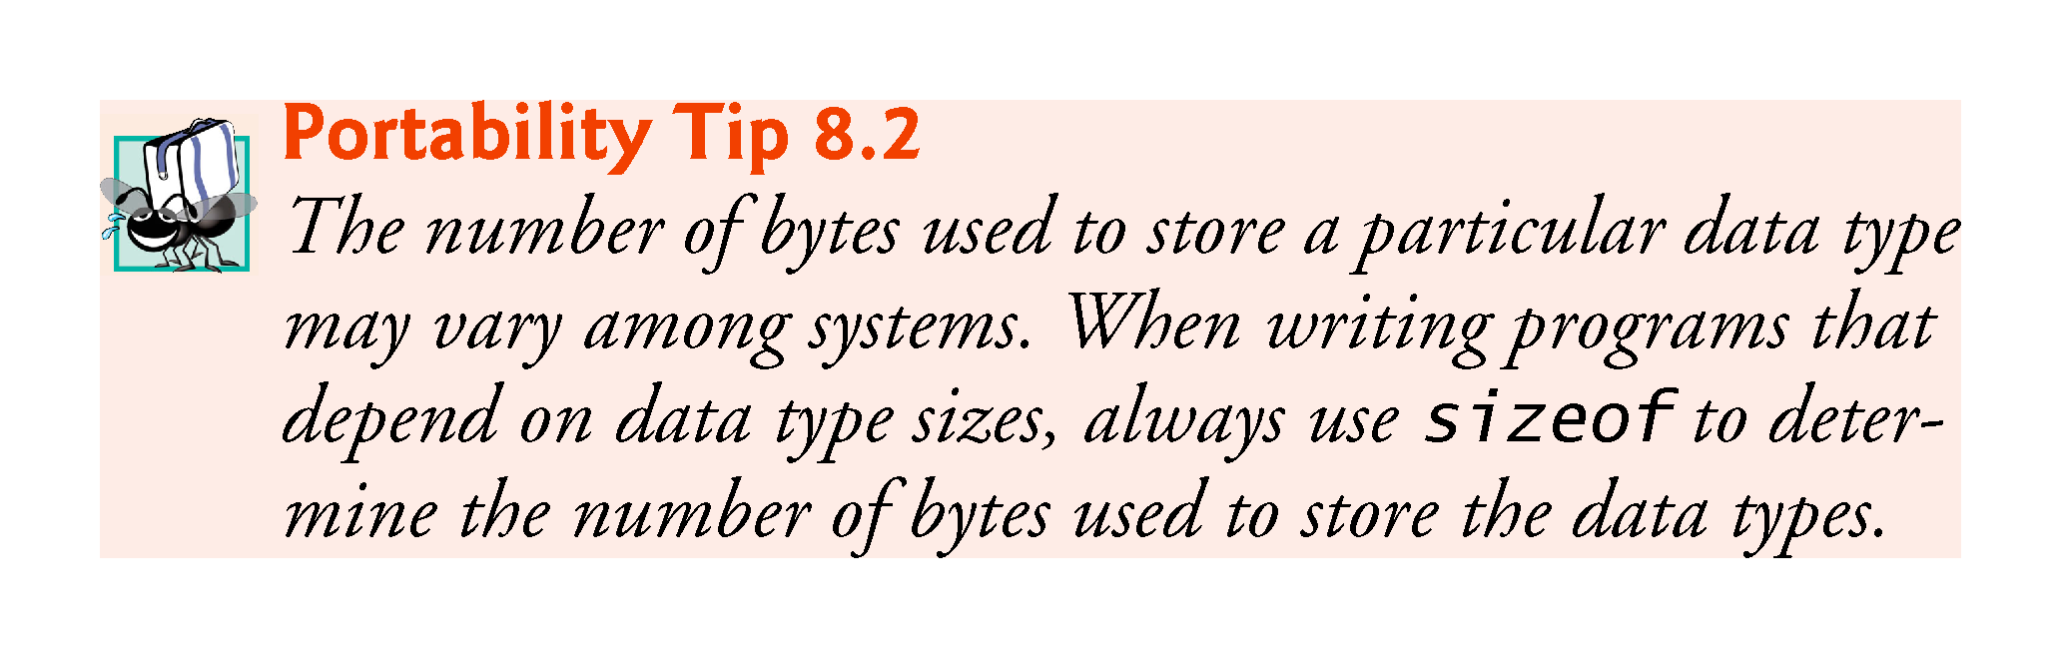

Slide 81
8.7 sizeof Operator (cont.)
Operator sizeof can be applied to any expression or type name.
When sizeof is applied to a variable name (which is not a built-in array’s name) or other expression, the number of bytes used to store the specific type of the expression is returned.
The parentheses used with sizeof are required only if a type name is supplied as its operand.

Slide 82
8.8 Pointer Expressions and Pointer Arithmetic
Pointers are valid operands in arithmetic expressions, assignment expressions and comparison expressions.
C++ enables pointer arithmetic—a few arithmetic operations may be performed on pointers:
increment (++)
decremented (--)
an integer may be added to a pointer (+ or +=)
an integer may be subtracted from a pointer (- or -=)
one pointer may be subtracted from another of the same type—this particular operation is appropriate only for two pointers that point to elements of the same built-in array

Slide 83
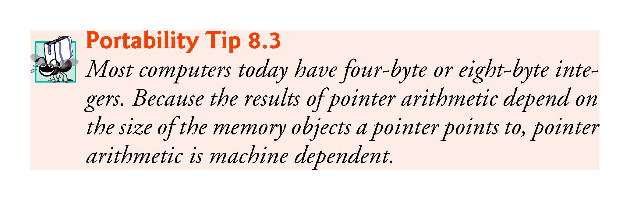

Slide 84
8.8 Pointer Expressions and Pointer Arithmetic
Assume that int v[5] has been declared and that its first element is at memory location 3000.
Assume that pointer vPtr has been initialized to point to v[0] (i.e., the value of vPtr is 3000).
Figure 8.15 diagrams this situation for a machine with four-byte integers. Variable vPtr can be initialized to point to v with either of the following statements:
int* vPtr{v};
int* vPtr{&v[0]};

Slide 85
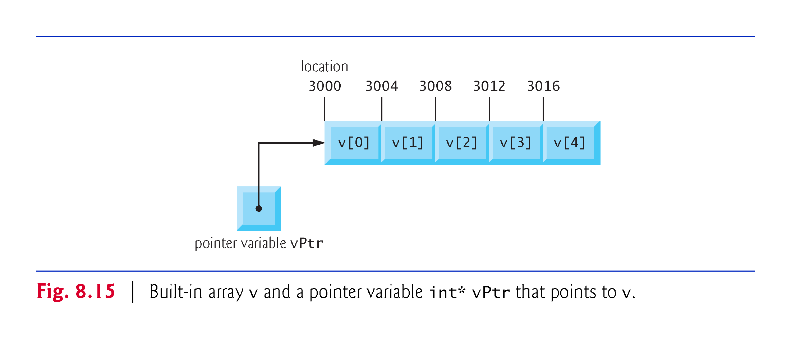

Slide 86
8.8.1 Adding Integers to and Subtracting Integers from Pointers
In conventional arithmetic, the addition 3000 + 2 yields the value 3002.
This is normally not the case with pointer arithmetic.
When an integer is added to, or subtracted from, a pointer, the pointer is not simply incremented or decremented by that integer, but by that integer times the size of the memory object to which the pointer refers.
The number of bytes depends on the memory object’s data type.

Slide 87
8.8.1 Adding Integers to and Subtracting Integers from Pointers
vPtr += 2;
would produce 3008 (from the calculation 3000 + 2 * 4), assuming that an int is stored in four bytes of memory.
In the built-in array v, vPtr would now point to v[2] (Fig. 8.16).
If an integer is stored in eight bytes of memory, then the preceding calculation would result in memory location 3016 (3000 + 2 * 8).

Slide 88
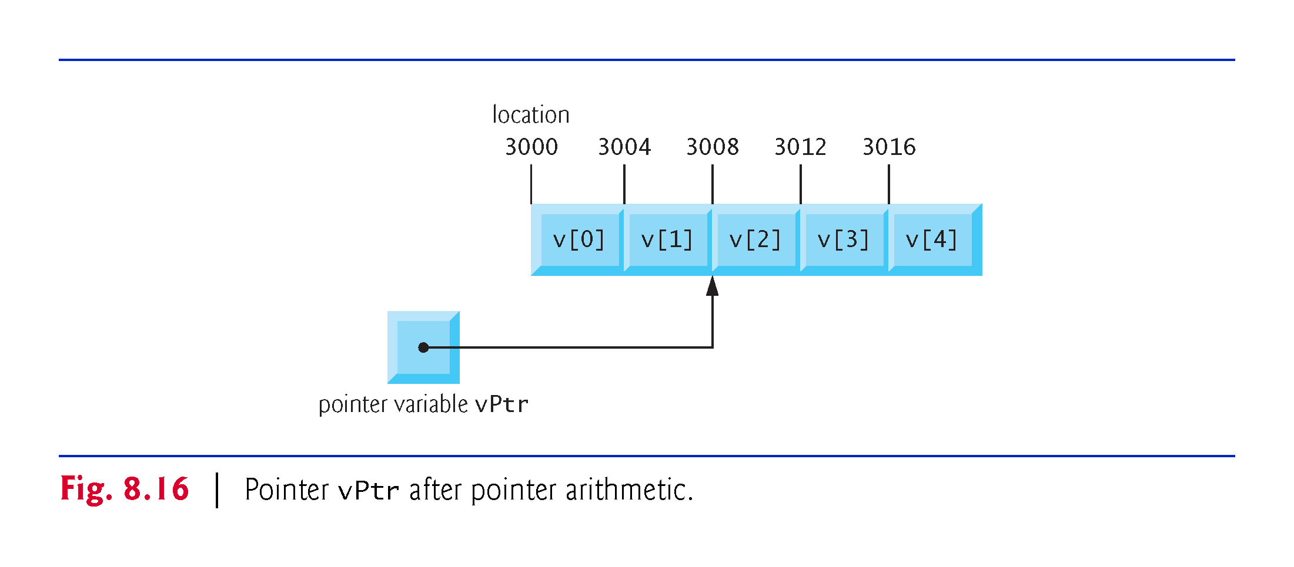

Slide 89
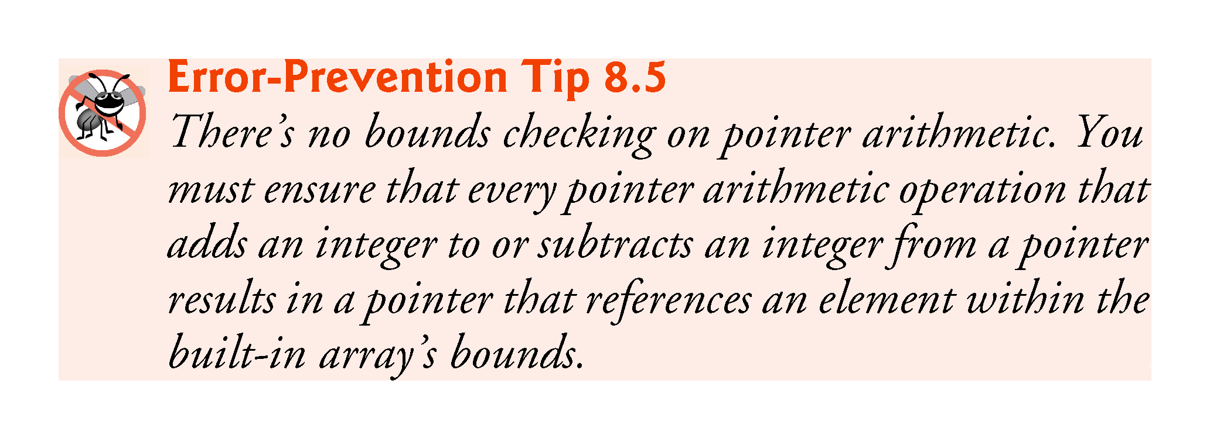

Slide 90
8.8.3 Subtracting Pointers
Pointer variables pointing to the same built-in array may be subtracted from one another.
For example, if vPtr contains the address 3000 and v2Ptr contains the address 3008, the statement
x = v2Ptr - vPtr;
would assign to x the number of built-in array elements from vPtr to v2Ptr—in this case, 2.
Pointer arithmetic is meaningful only on a pointer that points to a built-in array.

Slide 91
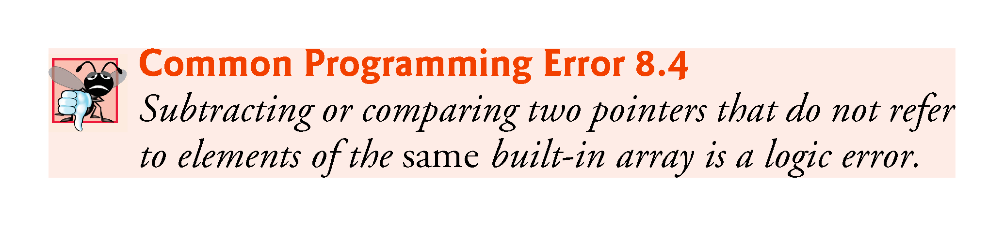

Slide 92
8.8.3 Pointer Assignment
A pointer can be assigned to another pointer if both pointers are of the same type.
Otherwise, a cast operator (normally a reinterpret_cast; discussed in Section 14.7) must be used to convert the value of the pointer on the right of the assignment to the pointer type on the left of the assignment.
Exception to this rule is the pointer to void (i.e., void*).
Any pointer to a fundamental type or class type can be assigned to a pointer of type void* without casting.

Slide 93
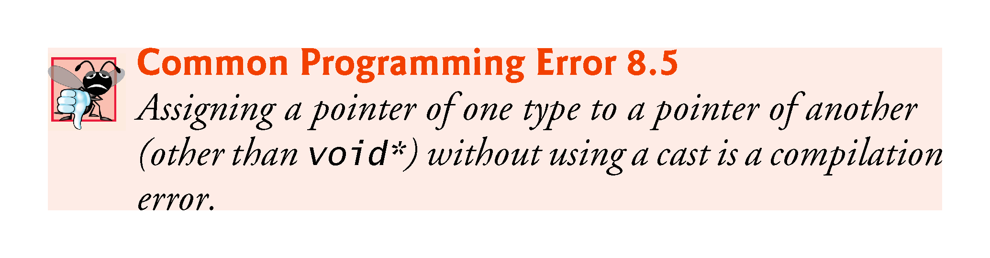

Slide 94
8.8.4 Cannot Dereference a void*
A void* pointer cannot be dereferenced.
The compiler “knows” that an int* points to four bytes of memory on a machine with four-byte integers—dereferencing an int* creates an lvalue that is an alias for the int’s four bytes in memory.
A void* simply contains a memory address for an unknown data type.
You cannot dereference a void* because the compiler does not know the type of the data to which the pointer refers and thus not the number of bytes.

Slide 95
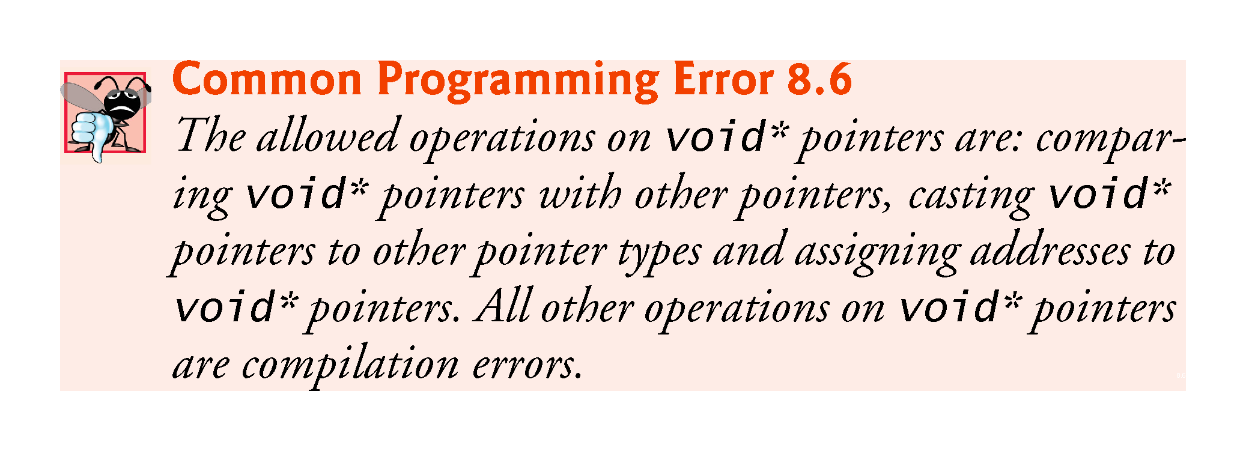

Slide 96
8.8.5 Comparing Pointers
Pointers can be compared using equality and relational operators.
Comparisons using relational operators are meaningless unless the pointers point to elements of the same built-in array.
Pointer comparisons compare the addresses stored in the pointers.
A common use of pointer comparison is determining whether a pointer has the value nullptr, 0 or NULL (i.e., the pointer does not point to anything).

Slide 97
8.9 Relationship Between Pointers and Built-In Arrays
Pointers can be used to do any operation involving array subscripting.
Assume the following declarations:
// create 5-element int array b; b is a const pointer
int b[5]; // create int pointer bPtr, which isn't a const pointer
int* bPtr;

Slide 98
8.9 Relationship Between Pointers and Built-In Arrays
We can set bPtr to the address of the first element in the built-in array b with the statement
// assign address of built-in array b to bPtr
bPtr = b;
This is equivalent to assigning the address of the first element as follows:
// also assigns address of built-in array b to bPtr
bPtr = &b[0];

Slide 99
8.9.1 Pointer/Offset Notation
Built-in array element b[3] can alternatively be referenced with the pointer expression
*(bPtr + 3)
The 3 in the preceding expression is the offset to the pointer.
This notation is referred to as pointer/offset notation.
The parentheses are necessary, because the precedence of * is higher than that of +.

Slide 100
8.9 Relationship Between Pointers and Built-In Arrays (cont.)
Just as the built-in array element can be referenced with a pointer expression, the address
&b[3]
can be written with the pointer expression
bPtr + 3

Slide 101
8.9.2 Pointer/Offset Notation with the Built-In Array’s Name as the Pointer
The built-in array name can be treated as a pointer and used in pointer arithmetic.
For example, the expression
*(b + 3)
also refers to the element b[3].
In general, all subscripted built-in array expressions can be written with a pointer and an offset.

Slide 102
8.9.3 Pointer/Subscript Notation
Pointers can be subscripted exactly as built-in arrays can.
For example, the expression
bPtr[1]
refers to b[1]; this expression uses pointer/subscript notation.

Slide 103
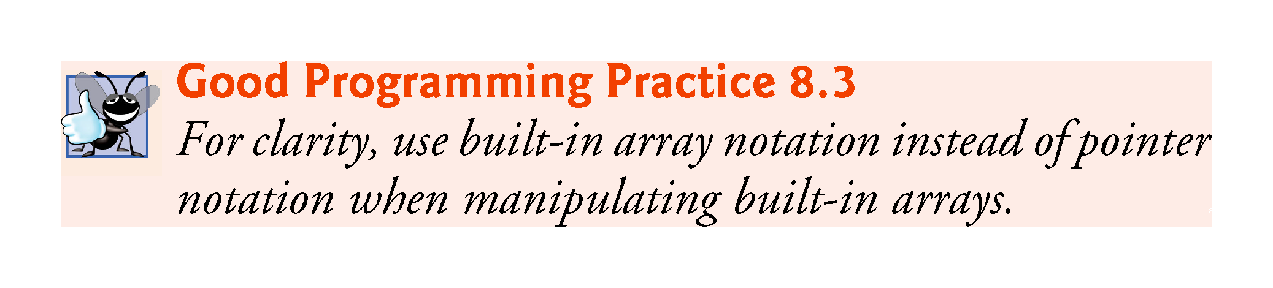

Slide 104
8.9.4 Demonstrating the Relationship Between Pointers and Built-In Arrays
Figure 8.17 uses the four notations we just discussed
array subscript notation
pointer/offset notation with the built-in array’s name as a pointer
pointer subscript notation
pointer/offset notation with a pointer
to accomplish the same task, namely displaying the four elements of the built-in array of ints named b.

Slide 105
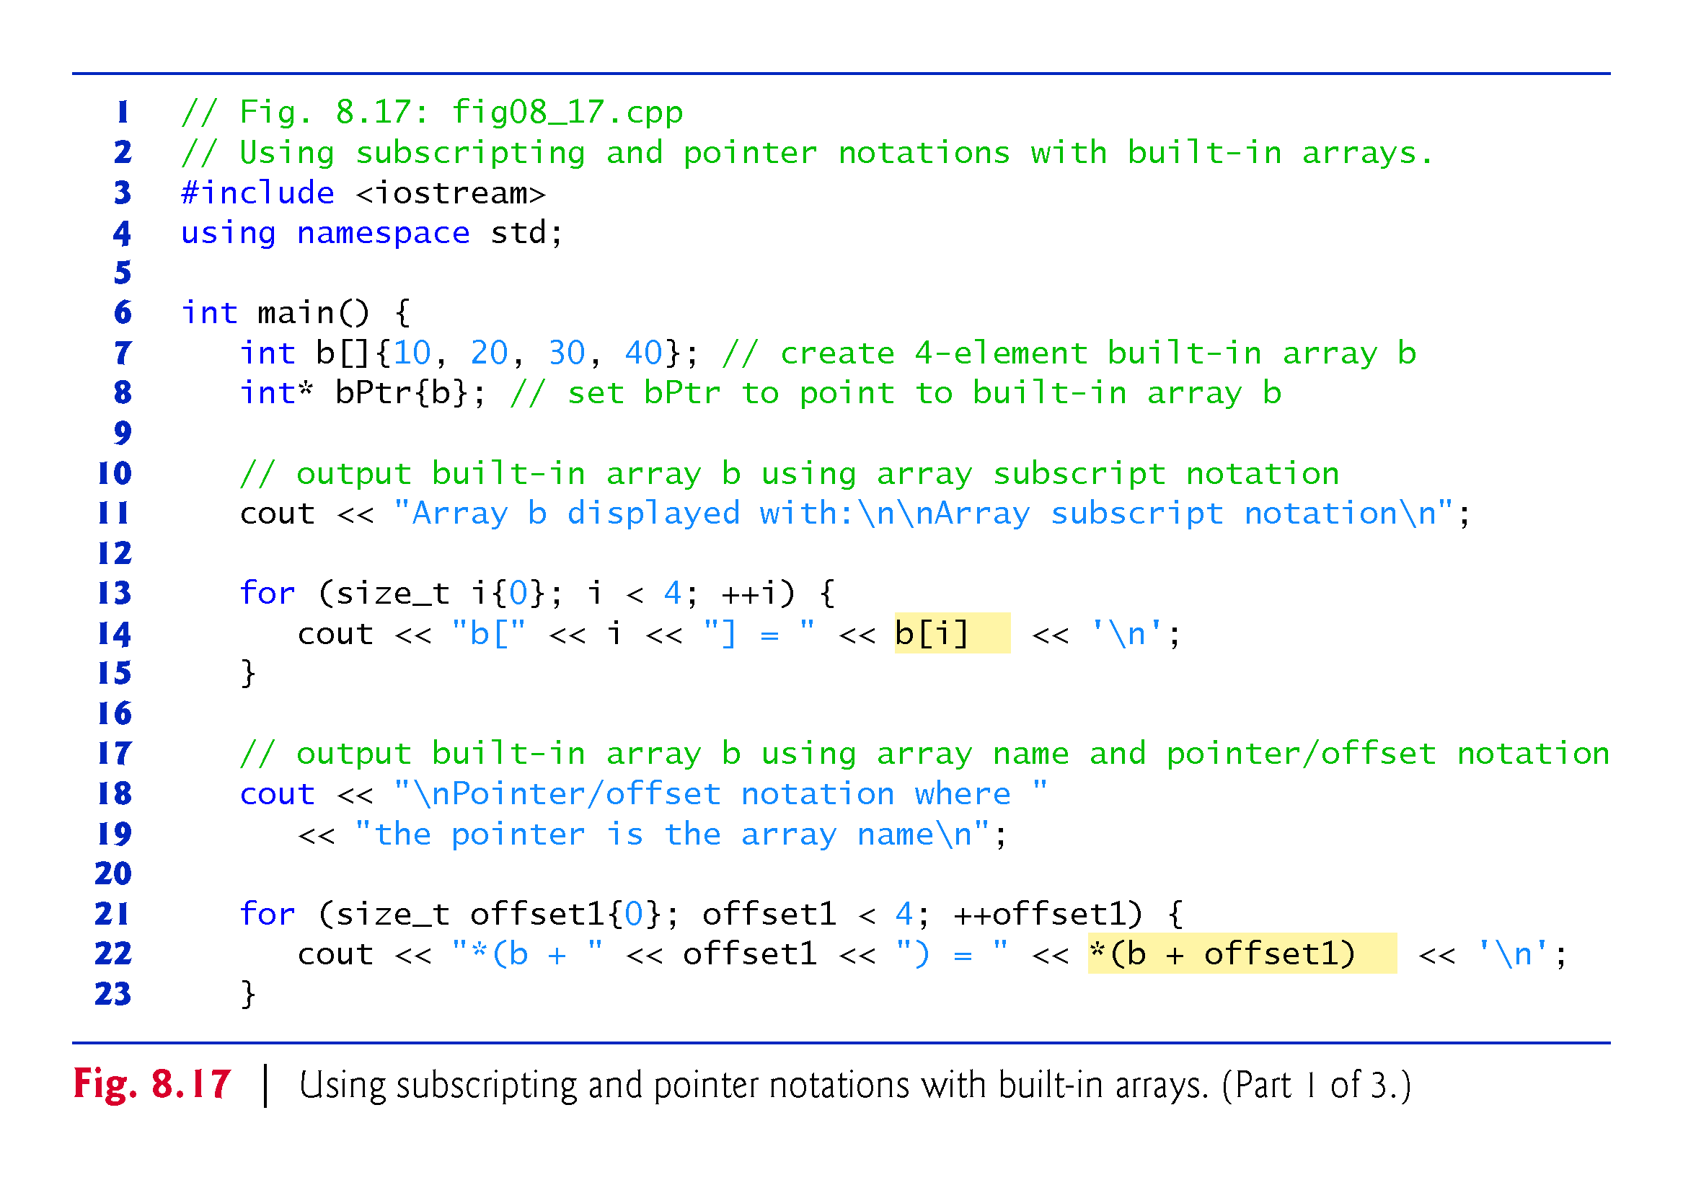

Slide 106


Slide 107


Slide 108
8.10 Pointer-Based Strings
This section introduces C-style, pointer-based strings, which we’ll simply call C strings.
C++’s string class is preferred
it eliminates many of the security problems that can be caused by manipulating C strings.
We cover C strings for a deeper understanding of arrays, and because there are some cases in which C string processing is required.
Also, if you work with legacy C and C++ programs, you’re likely to encounter pointer-based strings.

Slide 109
8.10 Pointer-Based Strings (cont.)
Characters and Character Constants
Characters are the fundamental building blocks of C++ source programs.
Character constant
An integer value represented as a character in single quotes.
The value of a character constant is the integer value of the character in the machine’s character set.

Slide 110
8.10 Pointer-Based Strings (cont.)
Strings
A string is a series of characters treated as a single unit.
May include letters, digits and various special characters such as +, -, *, /and $.
String literals, or string constants, in C++ are written in double quotation marks

Slide 111
8.10 Pointer-Based Strings (cont.)
Pointer-Based Strings
A pointer-based string is a built-in array of characters ending with a null character ('\0').
A string is accessed via a pointer to its first character.
The sizeof a string literal is the length of the string including the terminating null character.

Slide 112
8.10 Pointer-Based Strings (cont.)
String Literals as Initializers
A string literal may be used as an initializer in the declaration of either a built-in array of chars or a variable of type const char*.
String literals exist for the duration of the program and may be shared if the same string literal is referenced from multiple locations in a program.

Slide 113
8.10 Pointer-Based Strings (cont.)
Character Constants as Initializers
When declaring a built-in array of chars to contain a string, the built-in array must be large enough to store the string and its terminating null character.

Slide 114


Slide 115


Slide 116


Slide 117
8.10 Pointer-Based Strings (cont.)
Accessing Characters in a C String
Because a C string is a built-in array of characters, we can access individual characters in a string directly with array subscript notation.

Slide 118
8.10 Pointer-Based Strings (cont.)
Reading Strings into Built-In Arrays of char with cin
A string can be read into a built-in array of chars using stream extraction with cin.
The setw stream manipulator can be used to ensure that the string read into word does not exceed the size of the built-in array.
Applies only to the next value being input.

Slide 119
8.10 Pointer-Based Strings (cont.)
Reading Lines of Text into Built-In Arrays of char with cin.getline
In some cases, it’s desirable to input an entire line of text into a built-in array of chars.
For this purpose, the cin object provides the member function getline, which takes three arguments—a built-in array of chars in which the line of text will be stored, a length and a delimiter character.
The function stops reading characters when the delimiter character '\n' is encountered, when the end-of-file indicator is entered or when the number of characters read so far is one less than the length specified in the second argument.
The third argument to cin.getline has '\n' as a default value.

Slide 120
8.10 Pointer-Based Strings (cont.)
Displaying C Strings
A built-in array of chars representing a null-terminated string can be output with cout and <<.
The characters are output until a terminating null character is encountered; the null character is not displayed.
cin and cout assume that built-in arrays of chars should be processed as strings terminated by null characters; cin and cout do not provide similar input and output processing capabilities for other built-in array types.

Slide 121
8.10 Pointer-Based Strings (cont.)
Displaying C Strings
A built-in array of chars representing a null-terminated string can be output with cout and <<.
The characters are output until a terminating null character is encountered; the null character is not displayed.
cin and cout assume that built-in arrays of chars should be processed as strings terminated by null characters; cin and cout do not provide similar input and output processing capabilities for other built-in array types.

Slide 122
8.11 Note About Smart Pointers
Later in the book, we introduce dynamic memory management with pointers, which allows you at execution time to create and destroy objects as needed.
Improperly managing this process is a source of subtle errors.
We’ll discuss “smart pointers,” which help you avoid dynamic memory management errors by providing additional functionality beyond that of built-in pointers.

